Slide 1
Epidemic Modeling of the Onset of
Social Activities (EMOSA Models):
Applications to Adolescent
Religious Involvement
Joe Rodgers & Andriy Koval
Lunch Bunch, March 11, 2011

Slide 2
Acknowledgements
EMOSA models have been in development for almost 25 years, as a collaborative effort shared with my colleague David Rowe, University of Arizona – who died in February, 2002
Other collaborators – Grad students Sylvia Meseck-Bushey, Maury Buster, Amber Johnson
Collaborator on today’s work – Andrey Koval, current OU Quant grad student

Slide 3
Introduction
EMOSA Models – Epidemic Models of the Onset of Social Activities
These models have been borrowed from the field of Epidemiology
They originated from May-Anderson models, which describe the spread bacteria, viruses, etc. through biological contagion
But our application involves social contagion

Slide 4
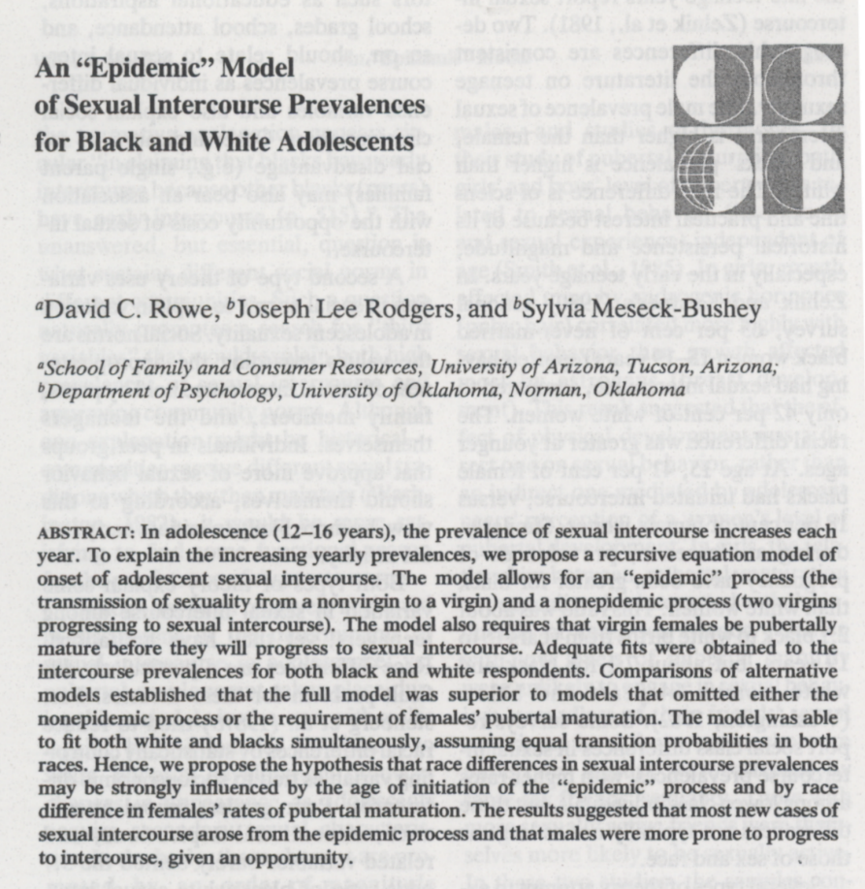
Past applications,
starting in 1989
Here’s our first
EMOSA paper, applied to the
onset of sexual
behavior – Social
Biology, 1989

Slide 5
We developed theory in a 1993 Psych Review paper and a 1998 Developmental Psych paper
We applied EMOSA to smoking and drinking in a 1993 paper, and in two book chapters in 2007
We applied EMOSA to crime and delinquency in another paper
All along we’ve claimed that EMOSA models could be used for behaviors other than adolescent problem behaviors – now we’re doing that, and will report results today
But first, some background

Slide 6
Overview
EMOSA Sexuality Models
Simple two-sex EMOSA sexuality model
Inter-cohort contagion model
Developmental EMOSA sexual development model
EMOSA sexuality/pregnancy/STD model
EMOSA Smoking and Drinking Models
Simple one-sex EMOSA smoking/drinking model
Stagewise EMOSA smoking/drinking model
The mathematics of social contagion
New data - the Oklahoma Smoking/Drinking Survey
New empirical results

Slide 7
A Simple EMOSA Sexuality Model
Rowe, Rodgers, & Meseck-Bushey, 1989, Social Biology:
P_{t+1} = P_{t} + T (P_{t}) (1-P_{t}) + k (1- P_{t}) (1-P_{t})
Carry-Over Epidemic Non-epidemic
P_{t} is prevalence at time t
T is the epidemic transmission parameter
k is the non-epidemic transmission parameter
Notes:
Only two categories. If there are three categories – number of transmission parameters will increase to accommodate the structure

Slide 8
There is actually one of these equations for each sex:
P_{m(t+1)} = P_{mt} + T_{m} (P_{ft}) (1-P_{mt}) + k (1- P_{mt}) (1-P_{ft})
P_{f(t+1)} = P_{ft} + T_{f} (P_{mt}) (1-P_{ft}) + k (1- P_{ft}) (1-P_{mt})
Notice how the two equations communicate with one another
These equations tell a story, they define a model –
Here’s another more conceptually straightforward look at the model

Slide 9
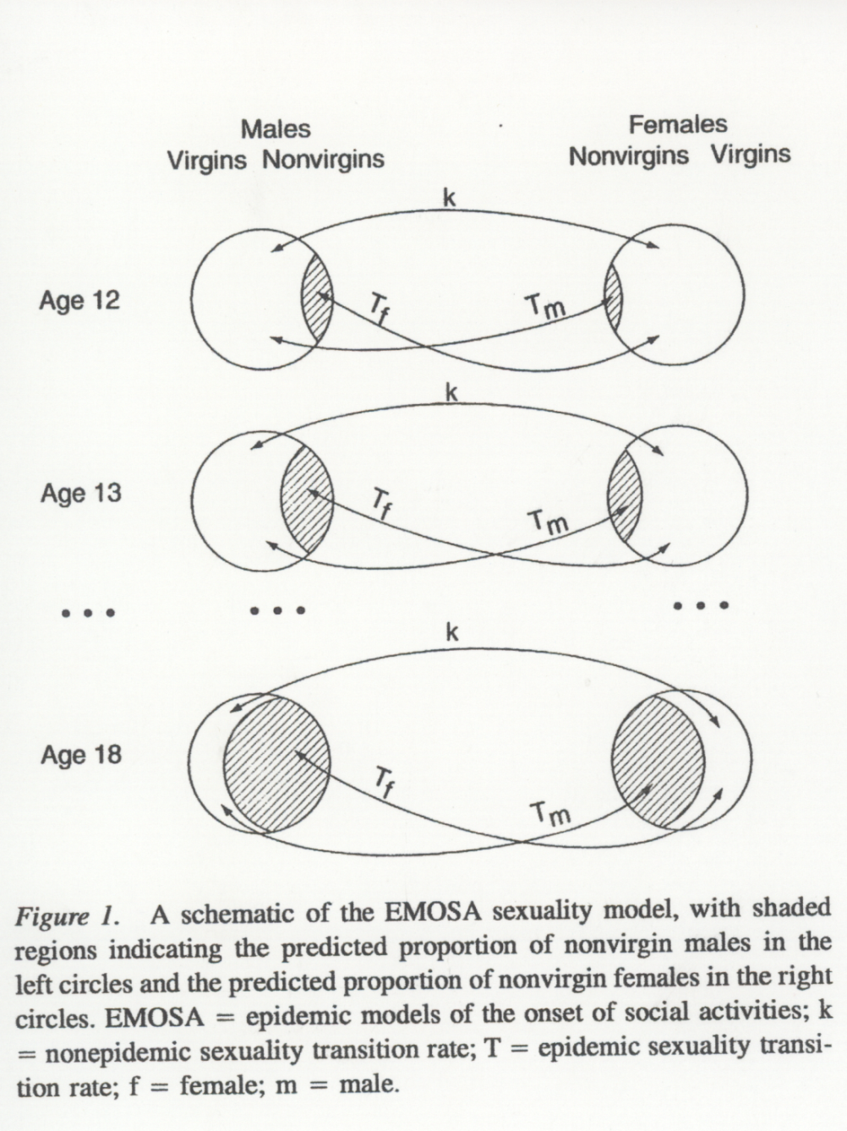
Figure 1, Rodgers, Rowe, & Buster, 1998, Developmental Psychology

Slide 10
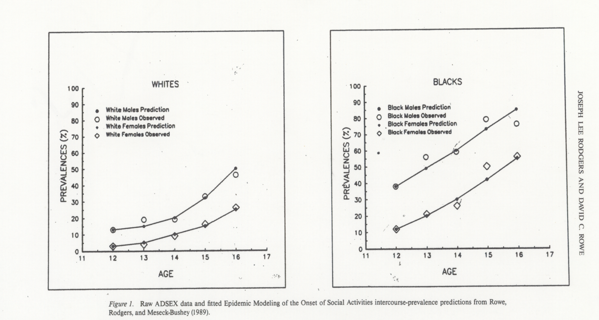
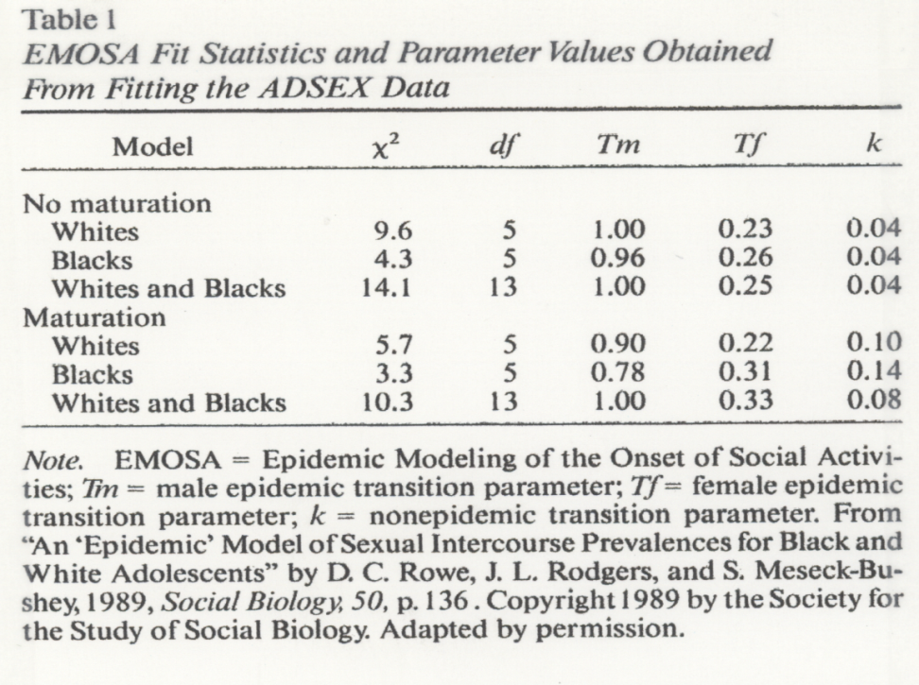
Fitting the first EMOSA Model to the ADSEX data from NC & FL

Slide 11
Important findings
Black/White differences in sexual behavior prevalences can be fully accounted for by pubertal development
Transition probabilities are typically interpretable -- higher for females-converting-males than vice versa, relatively low non-epidemic transition
Approximately constant probability of pregnancy across age -- contraceptive effectiveness and coital frequency compensatory?

Slide 12
EMOSA Smoking and Drinking Models
These work the same basic way that the sexuality models work, except that they’re single-sex models
Same types of filters, mixing adjustments, etc.
More focus on developmental stage models
Social congation versus General diffusion becomes important in the smoking/drinking models

Slide 13
Social contagion – social influence is passed from person to person
General diffusion – social influence is exerted through broader communication channels, like media, advertizing, literature, etc.
These two processes are similar, but have tremendously different policy implications
E.g., consider the delivery of a pregnancy reduction campaign to inner-city adolescent girls
Social contagion implies intervene at the friendship/dyad level
General diffusion implies use an ad campaign

Slide 14
These two processes can be distinguished within our mathematical models
Specifically, the shape of the prevalence curve is indicative of which process is at work
S-shaped curve – social contagion
Negatively accelerated exponential – general diffusion
Here are some graphical portrayals to illusrate, including some real data

Slide 16
From Rodgers, Rowe, & Buster (1998)

Slide 17
From Rodgers & Johnson (2007)

Slide 18
Work by David Rowe (Rowe et al, 1994) showed that onset of smoking is all about social contagion
But transition to regular smoking is all about general diffusion
In other words, kids start smoking because their friends encourage them to; they continue smoking because of the presence of a “smoking culture” in their families, on tv, in magazines, etc.

Slide 19
EMOSA Religious Involvement Model
In this new application, we posit the same type of social contagion – i.e., a social influence process that passes from person to person – as a potential for influencing religious behavior upon entry into college
We have longitudinal data, from the NLSY97, that reflects ongoing religious involvement behavior

Slide 20
Some conclusions
Nongoers are likely to stay goers. Highest resiliance
Goers rarely become Nongoers, they first become irregulars.
Goers become irregulars before they become non-goers
Nongoers never move back to goers, they become irregulars, for at least awhile
Goers are the most resilient, but once out, lots happens

Slide 22
Religious Involvement Data
National Longitudinal Survey of Youth (NLSY97)
Over 9,000 respondents
5,214 Included ( No missing data)
Age at 2000 : 16-20
Cohorts:
1980 – 1981 – 1982 – 1983 – 1984
Notes:
Five-year slice of population
So, first let’s talk about the structure of our new data, and later we will see how they relate to our EMOSA context

Slide 23
Religious Involvement Data
Q: “In the past year, how frequently did you attend a place of worship?”
8 | 'Everyday'
7 | 'Several times a week'
6 | 'About once a week'
5 | 'About twice a month'
4 | 'About once a month'
3 | 'Less than once a month'
2 | 'Once or twice'
1 | 'Never'
Goer
Irregular
Non-goer
Notes:
Goers – church at least every Sunday, perhaps involved in choir or some other church activity, not necessarily zealously religious, socially oriented towards church
Irregulars – church every other Sunday ( struggling christian), or maintaining nominal involvement with the church. Spectrum: from regularly skipping church to occasionally going to church
Non-goers – atheists, cultural Christians ( Easter, Christmas).

Slide 24
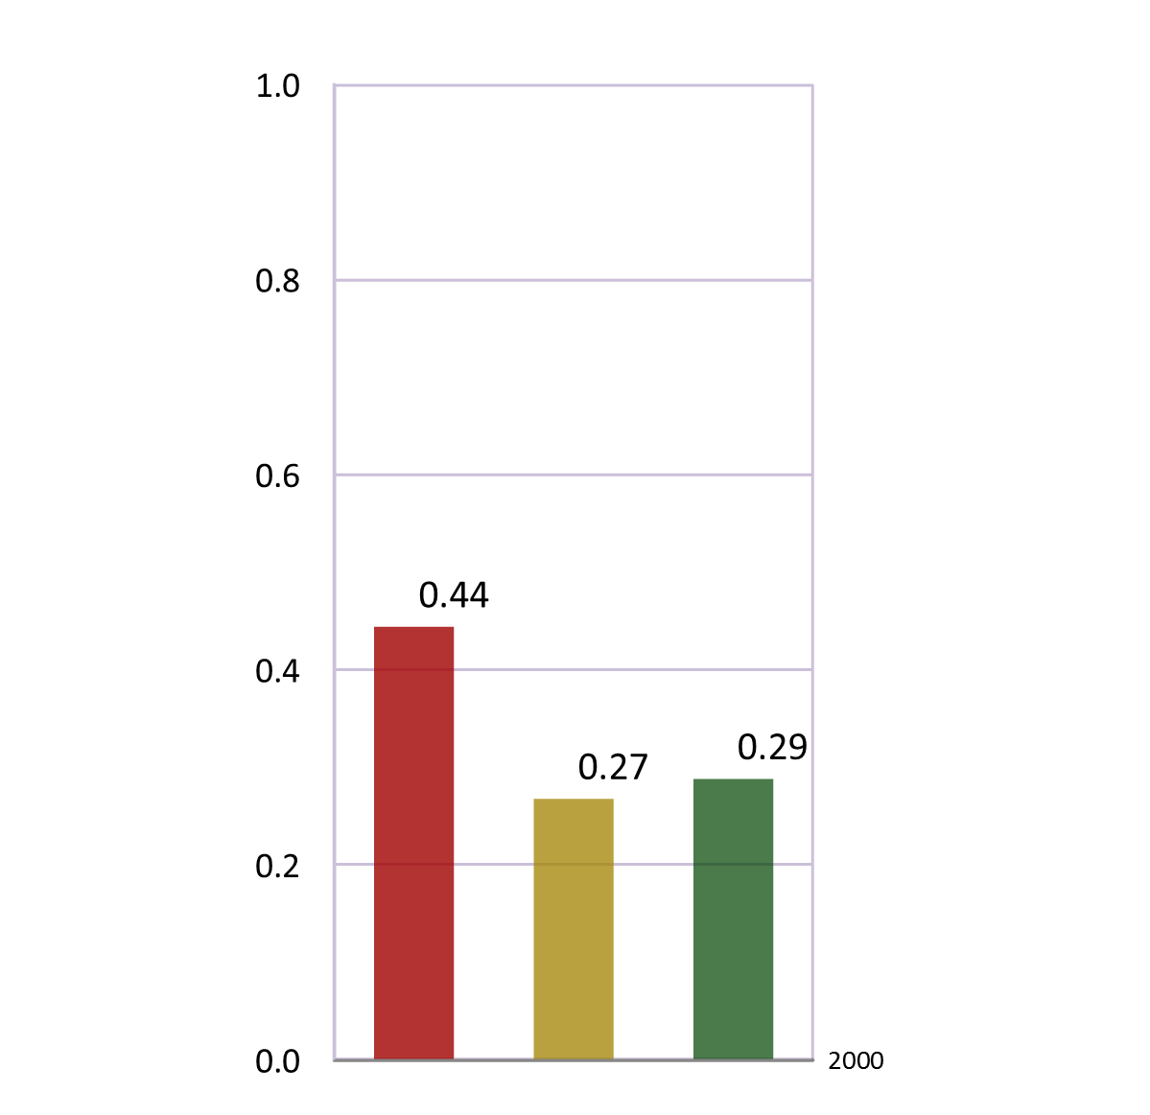
N = 5,214
Prevalence
2000
N
I
G

Slide 25
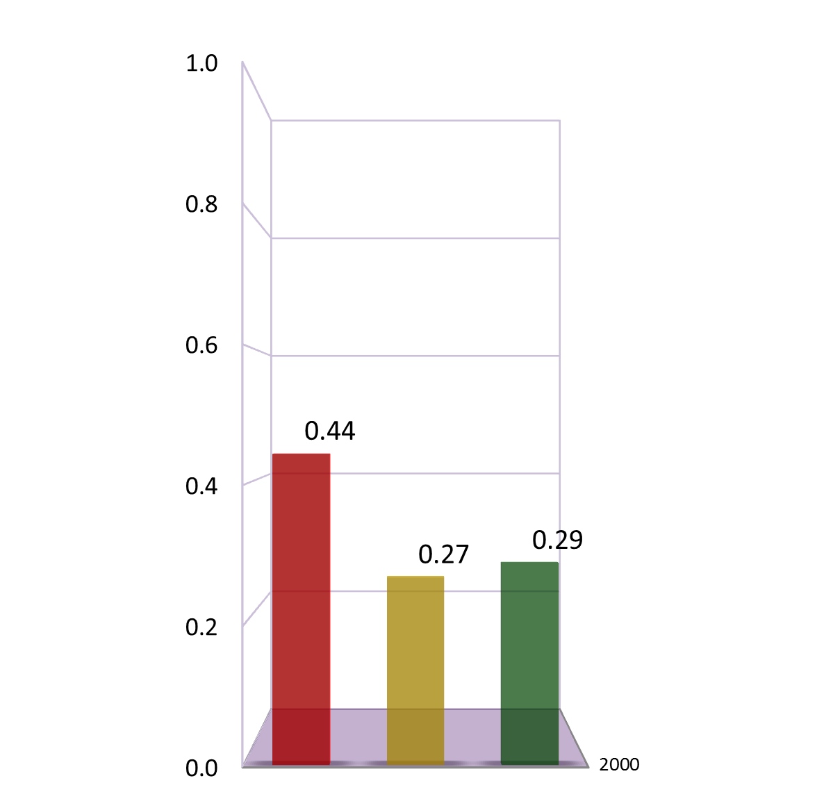
N = 5,214
Prevalence
2000
N
I
G

Slide 26
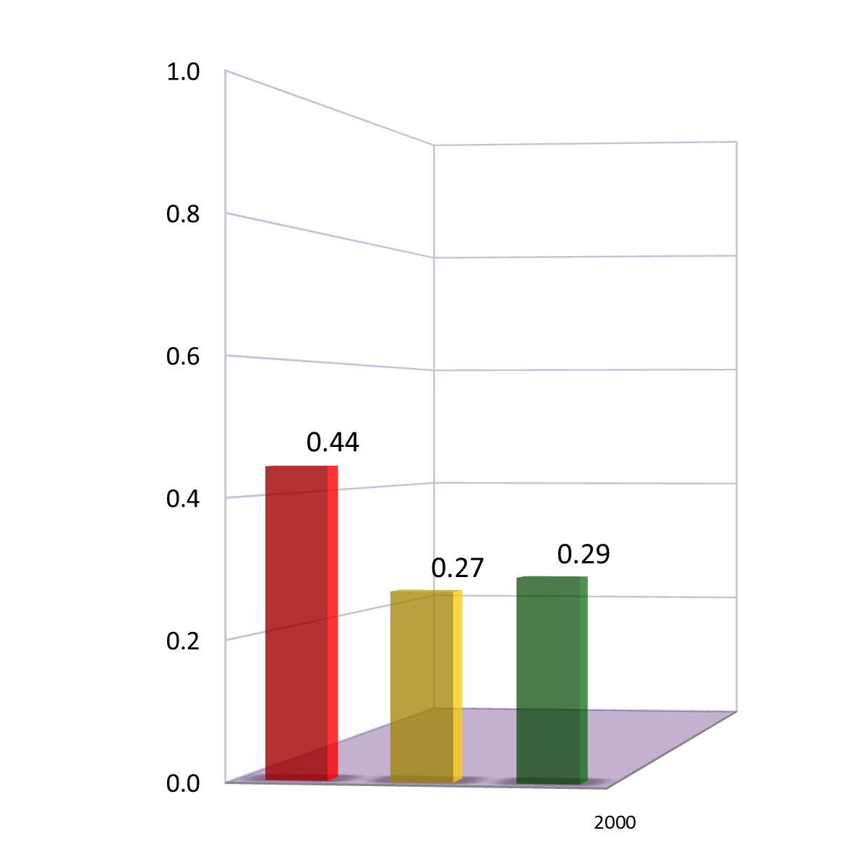
N = 5,214
Prevalence
N
I
G
2000

Slide 27
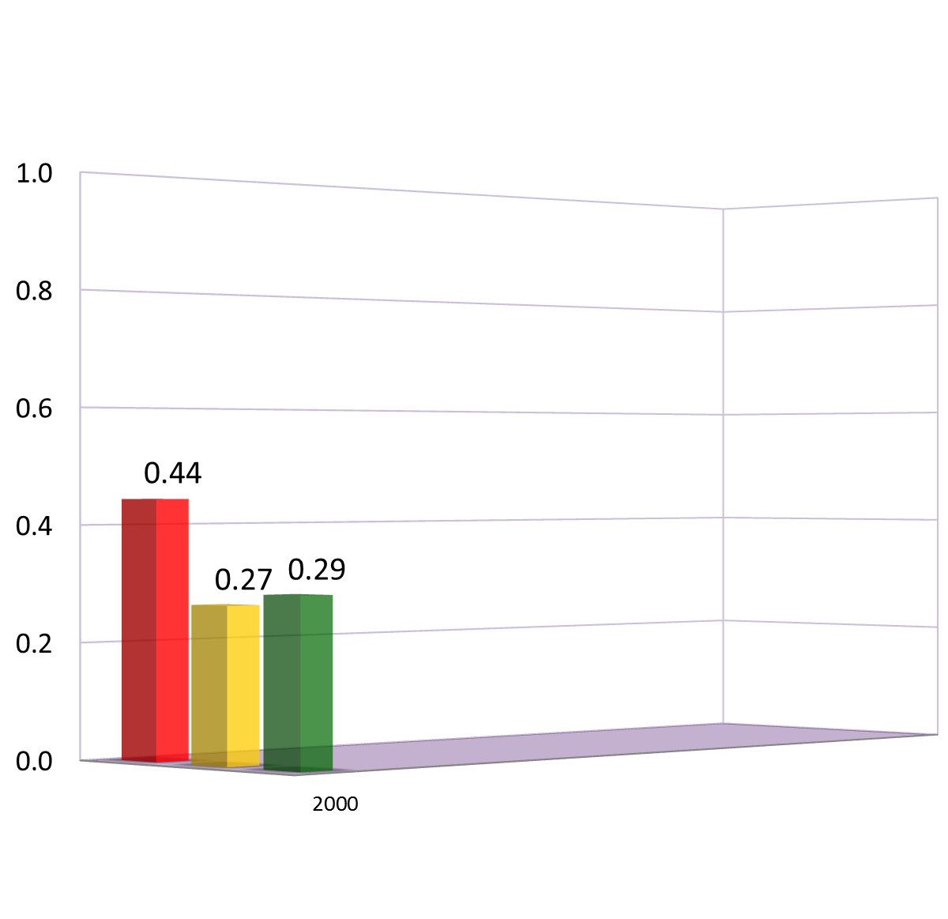
N = 5,214
Prevalence
N
I
G
2000

Slide 28
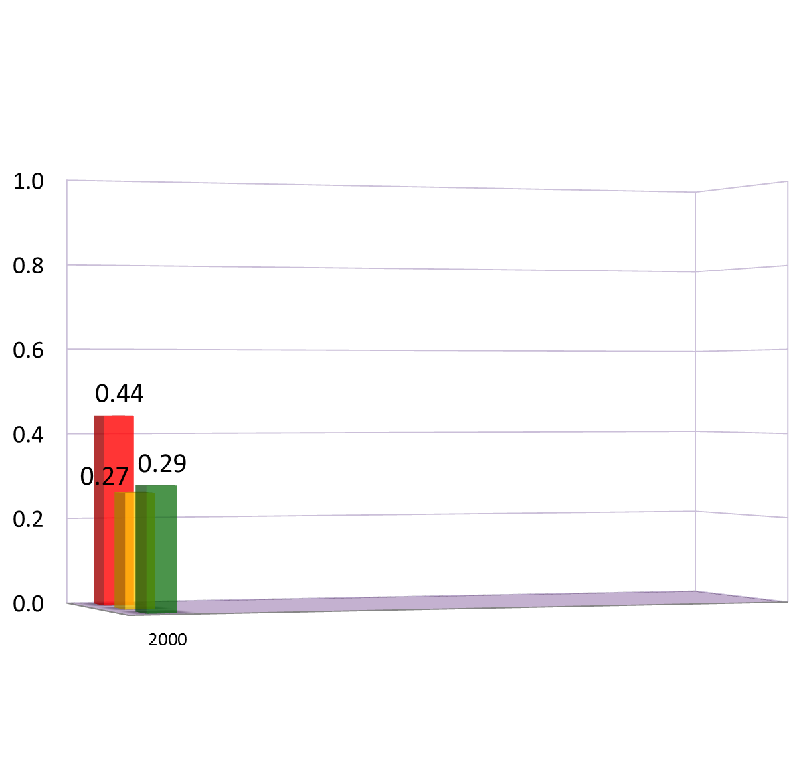
N = 5,214
Prevalence
N
I
G

Slide 29
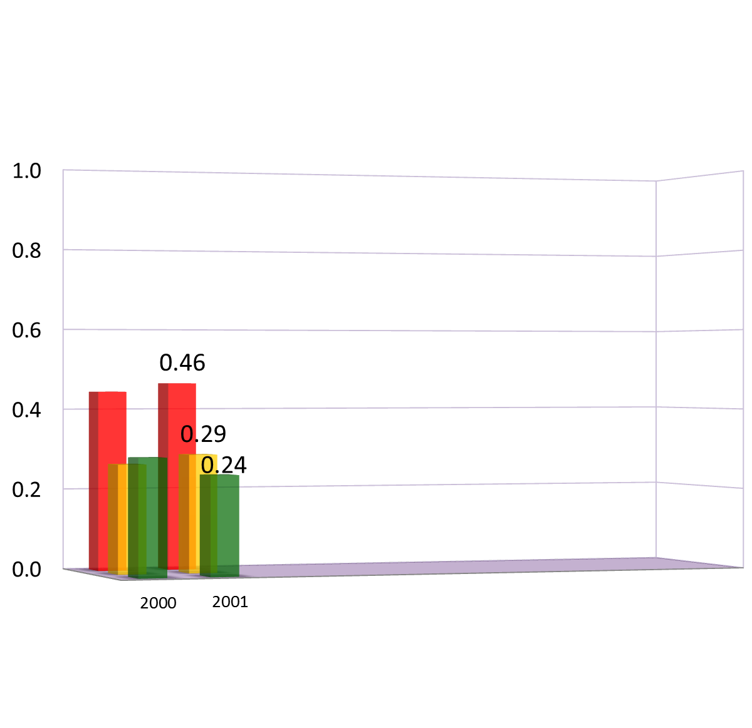
N = 5,214
Prevalence
N
I
G

Slide 30
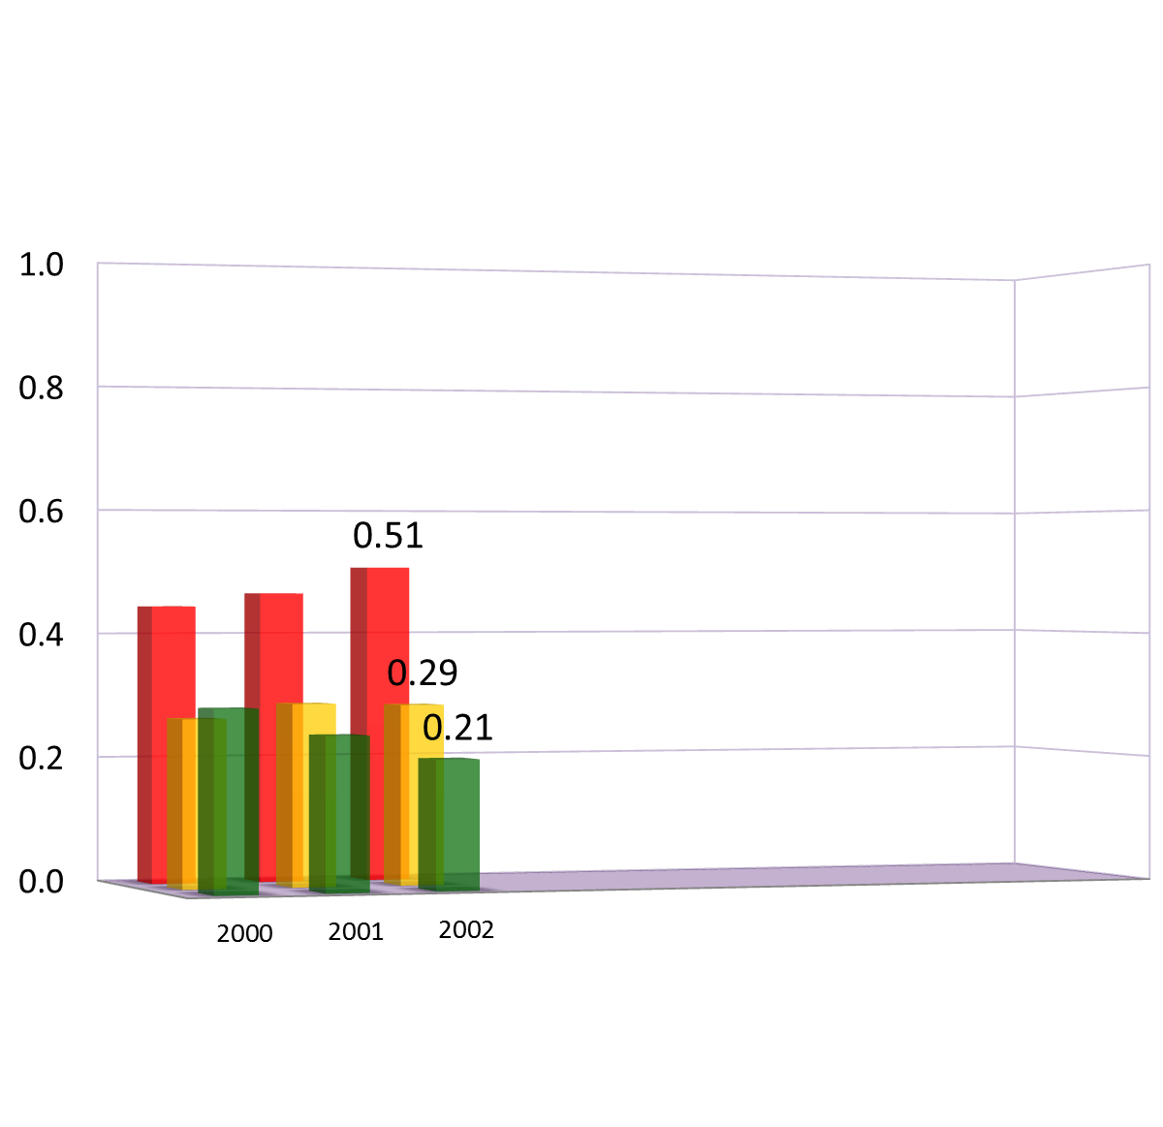
N = 5,214
Prevalence
N
I
G

Slide 31
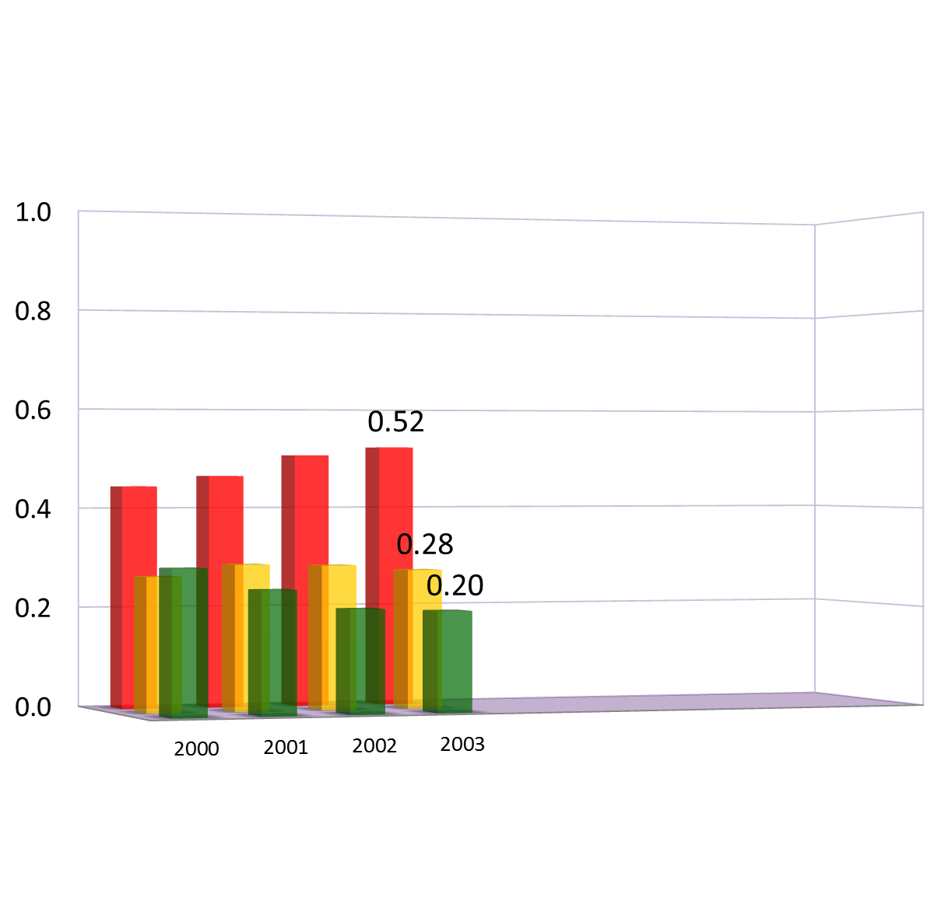
N = 5,214
Prevalence
N
I
G

Slide 32
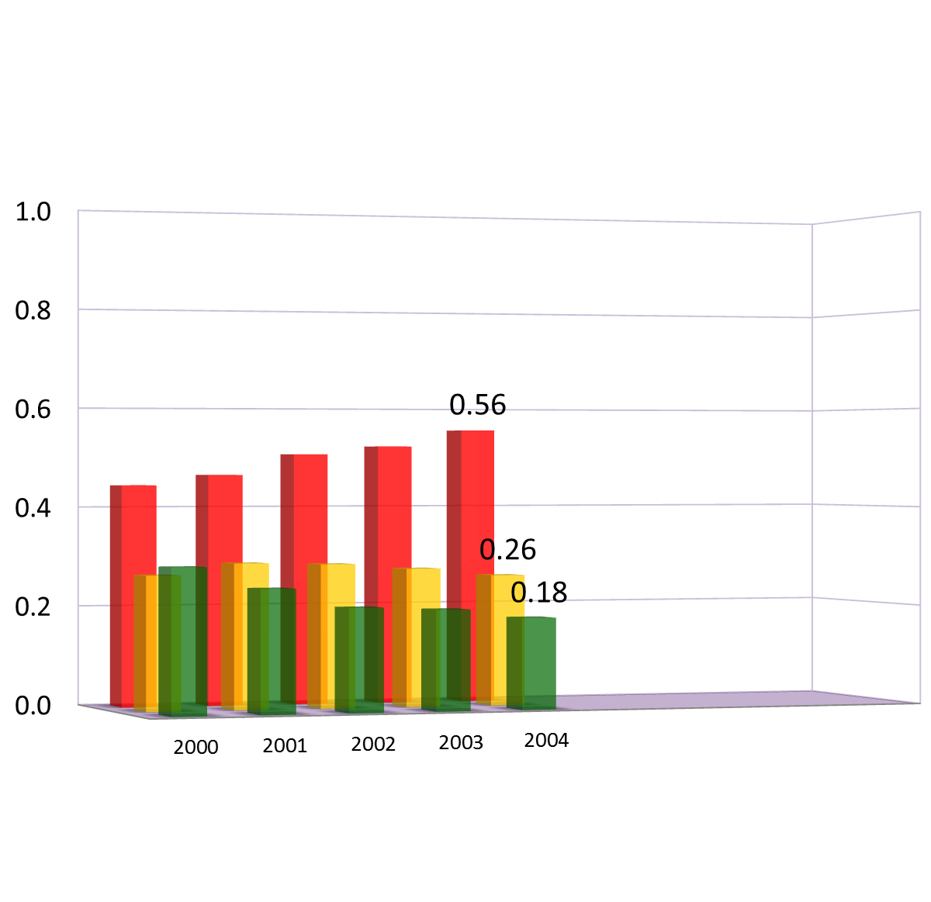
N = 5,214
Prevalence
N
I
G

Slide 33
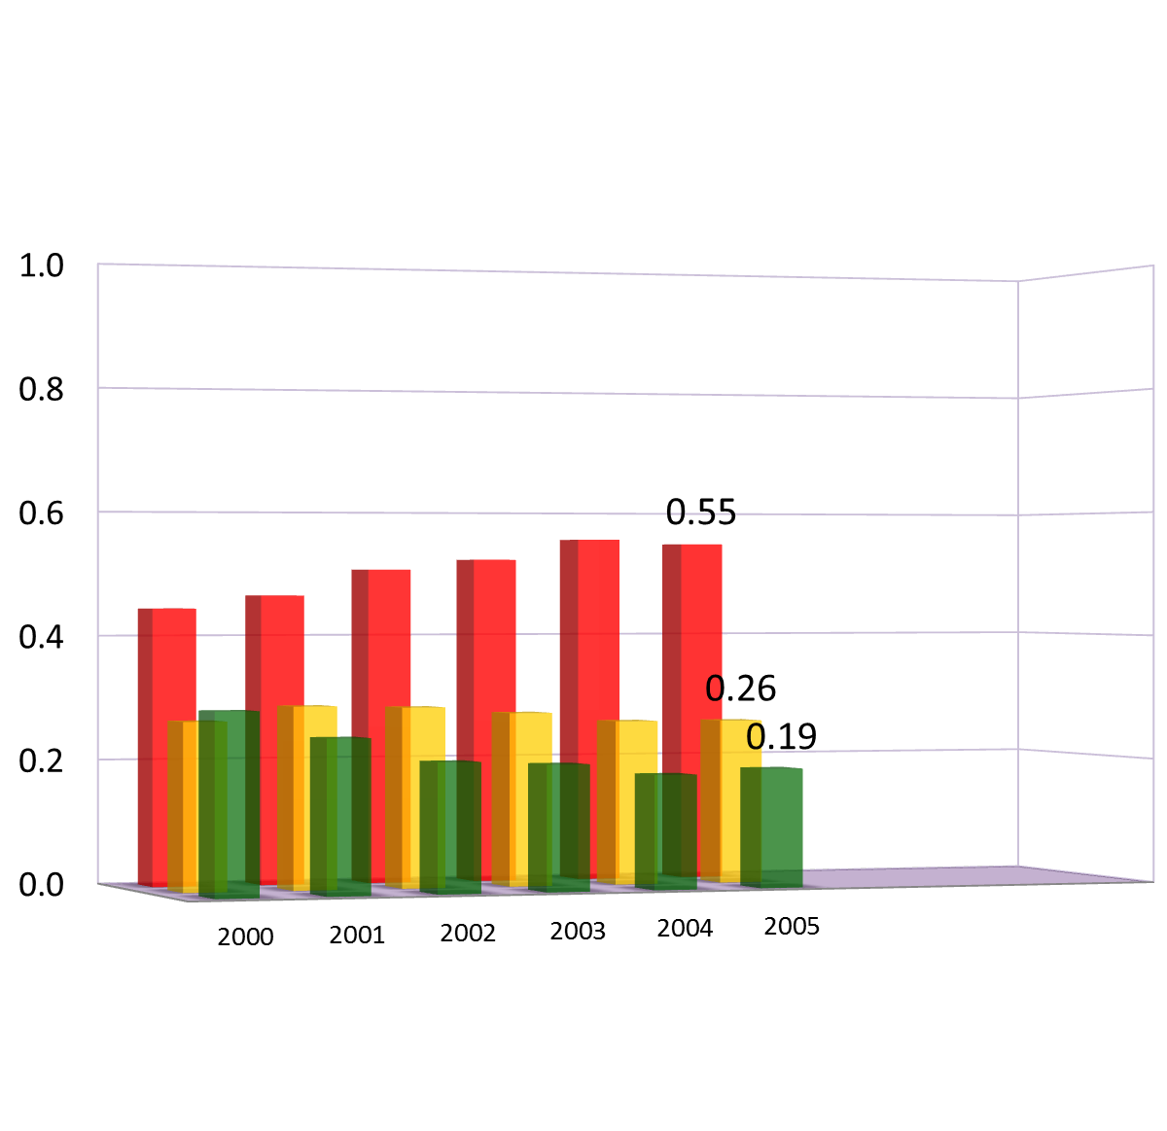
N = 5,214
Prevalence
N
I
G

Slide 34
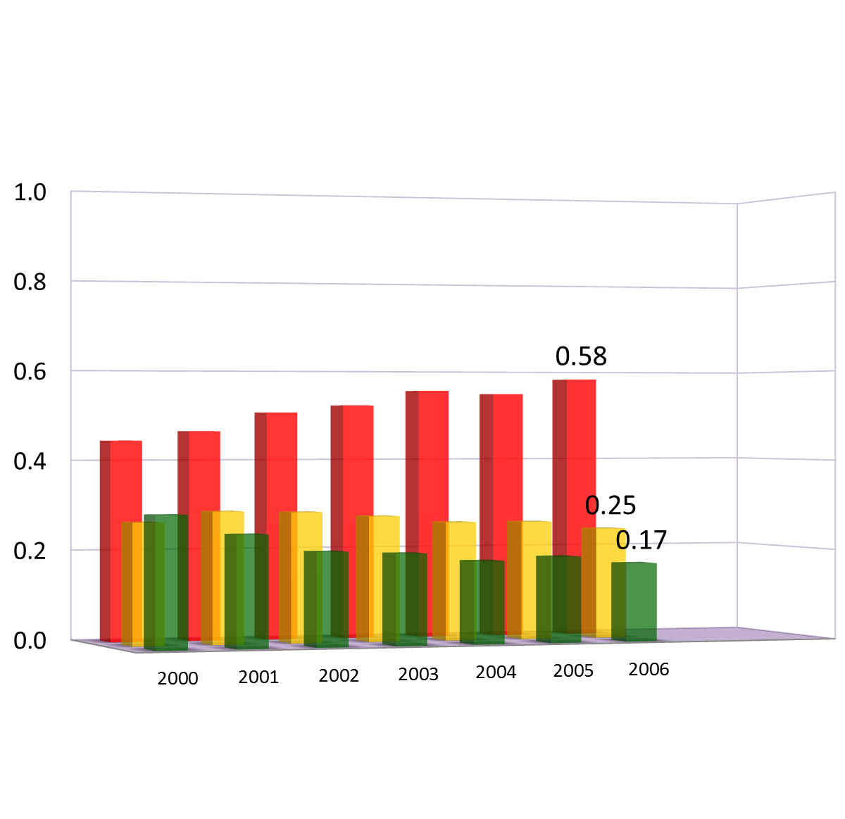
N = 5,214
Prevalence
N
I
G

Slide 35
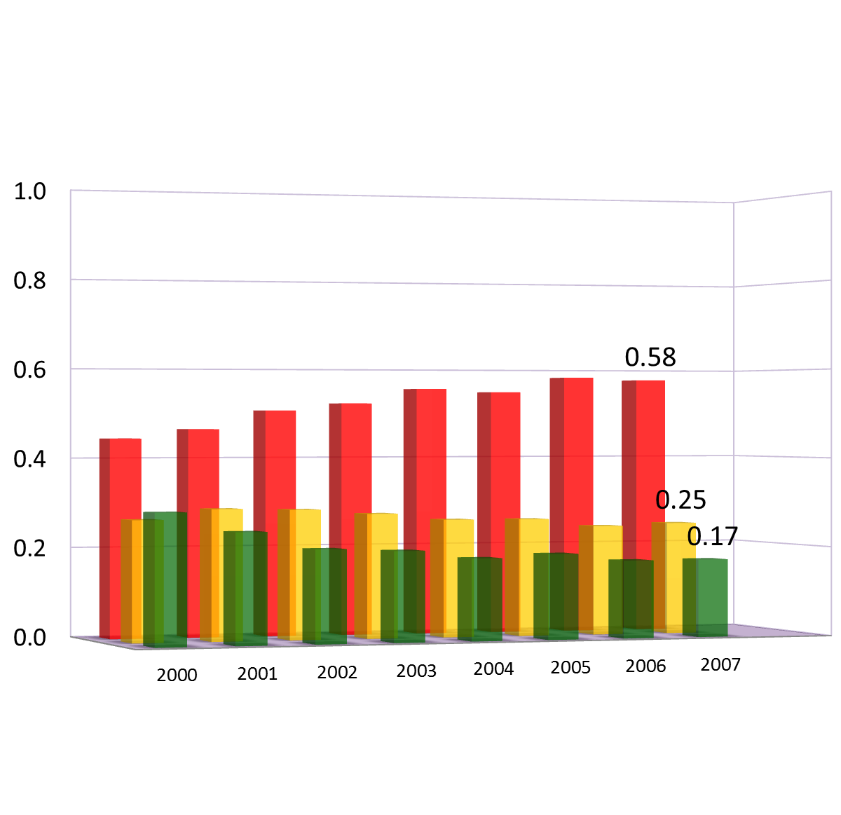
N = 5,214
Prevalence
N
I
G

Slide 36
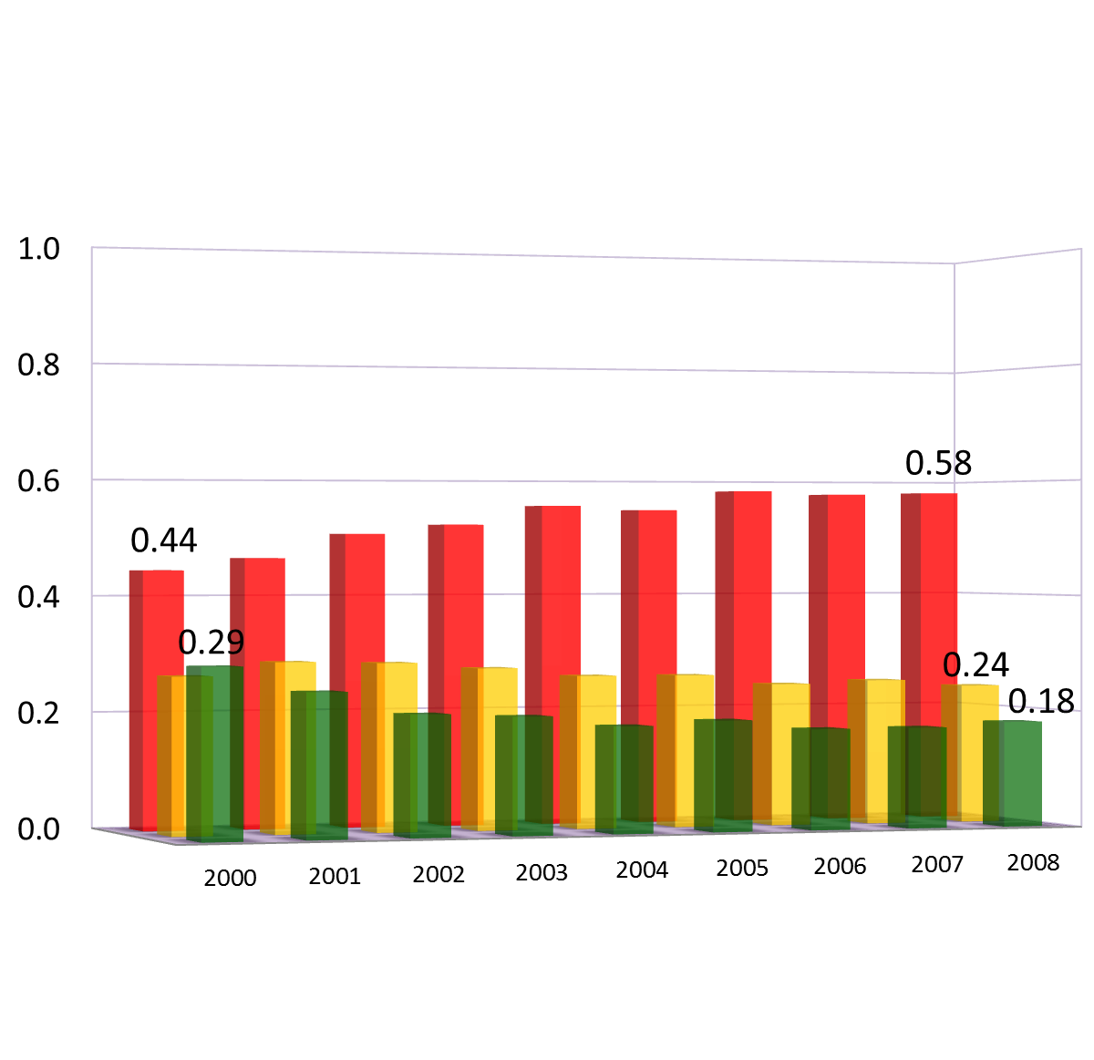
N = 5,214
Prevalence
N
I
G
Notes:
We see that the prevalence of behaviors changed substantially.
This is the aggregate data we normally see in EMOSA modeling. It does not count ACTUAL transitions from one category to another.
This could be an effect of AGE or TIME or INTERACTION of both.
Now that we got a big picture of what happened to religiosity over TIME and AGE, let’s look at individual behaviors

Slide 37
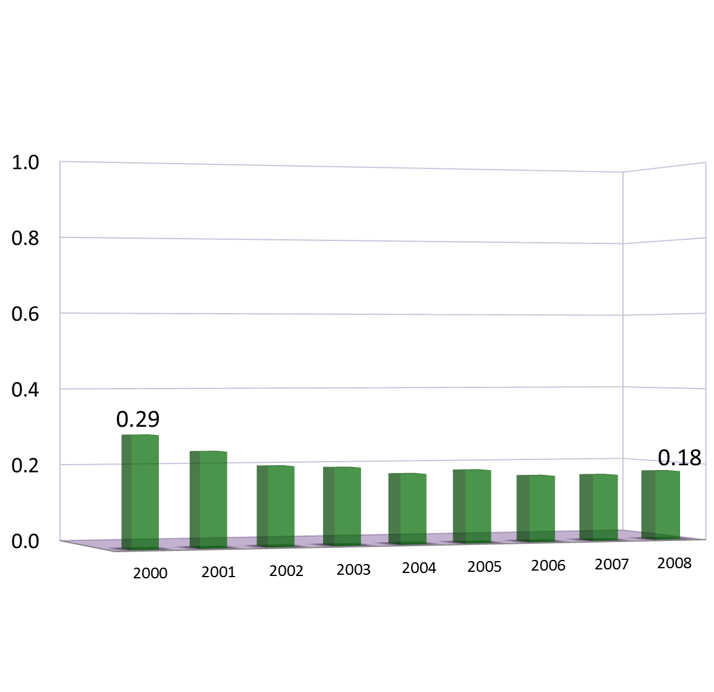
Prevalence
G

Slide 38
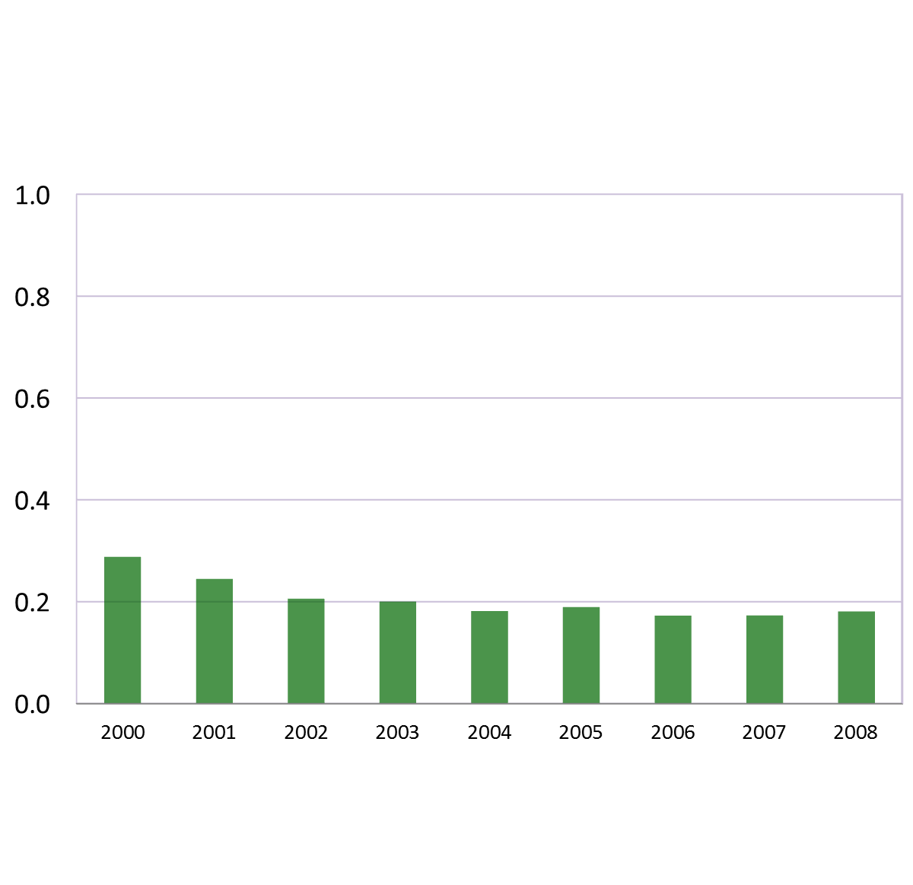
Prevalence

Slide 39
Prevalence

Slide 40
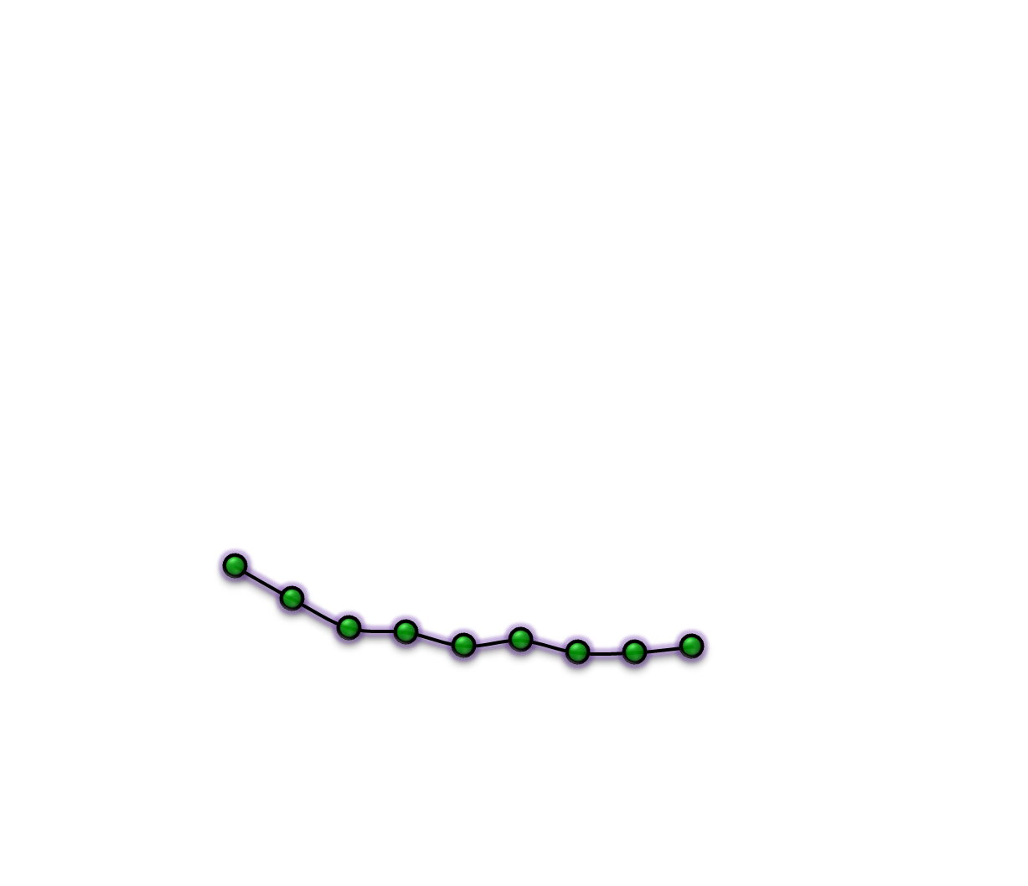
Prevalence

Slide 41
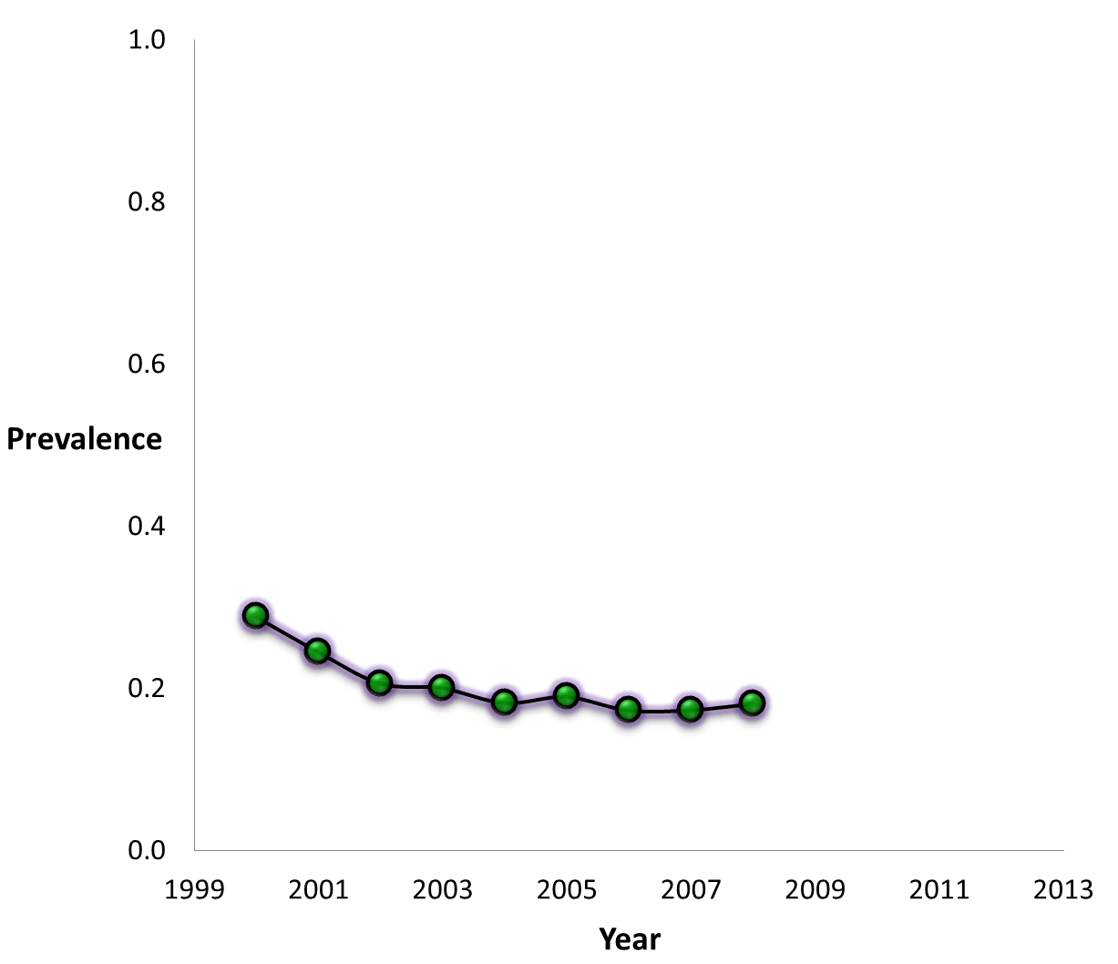

Slide 42
N
I
G

Slide 43
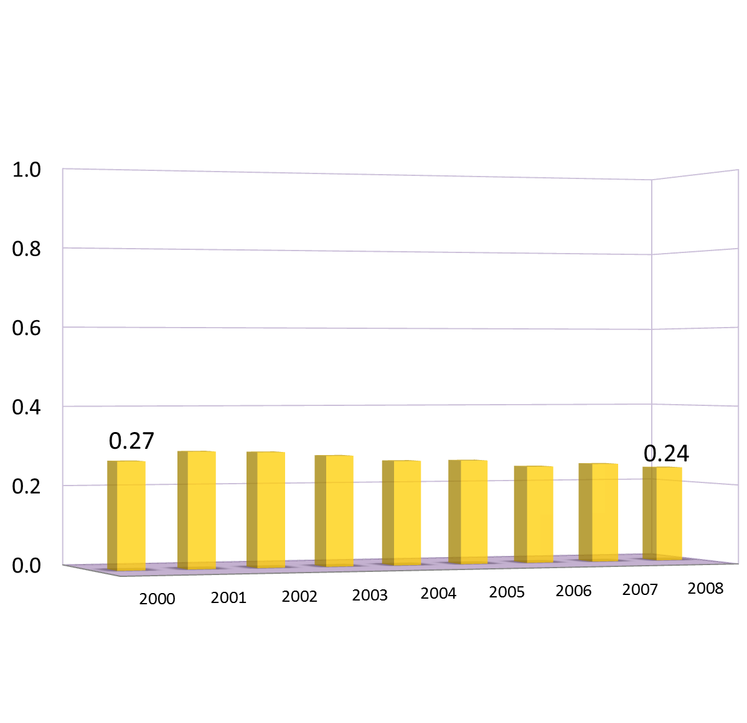
I

Slide 44
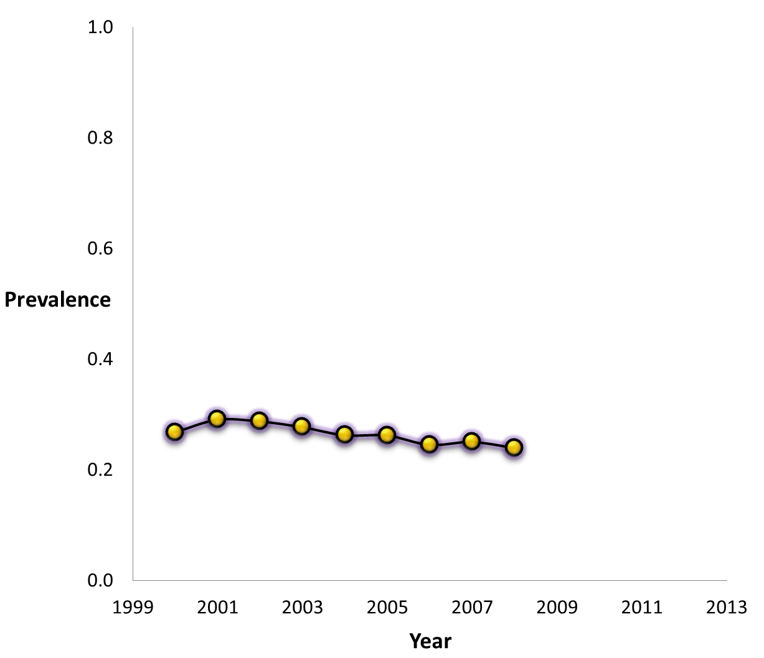

Slide 45
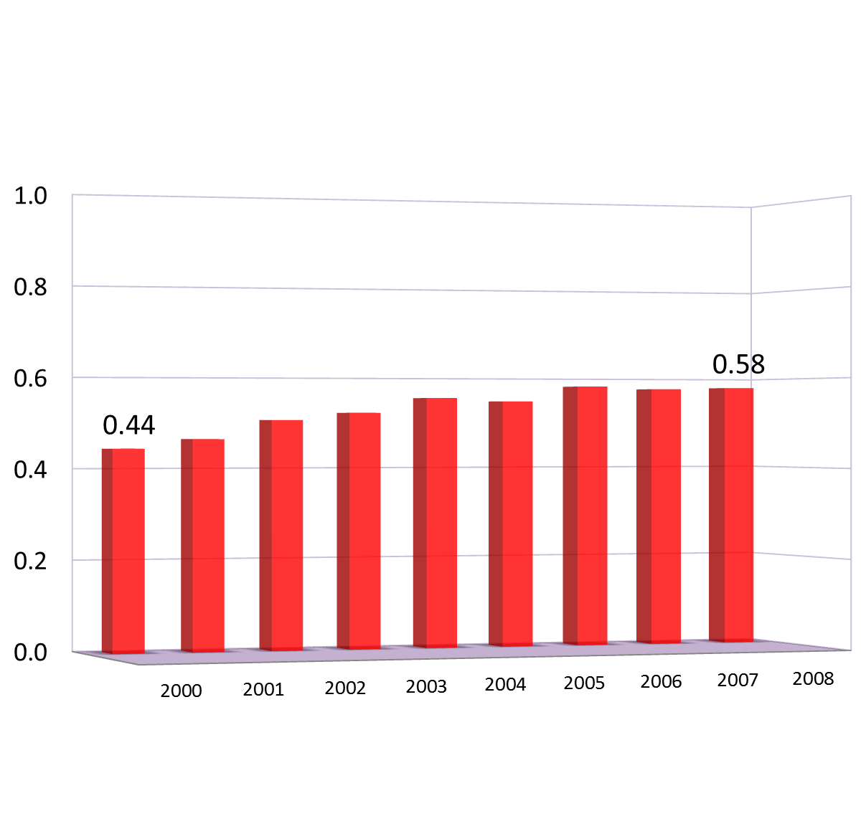
N

Slide 46
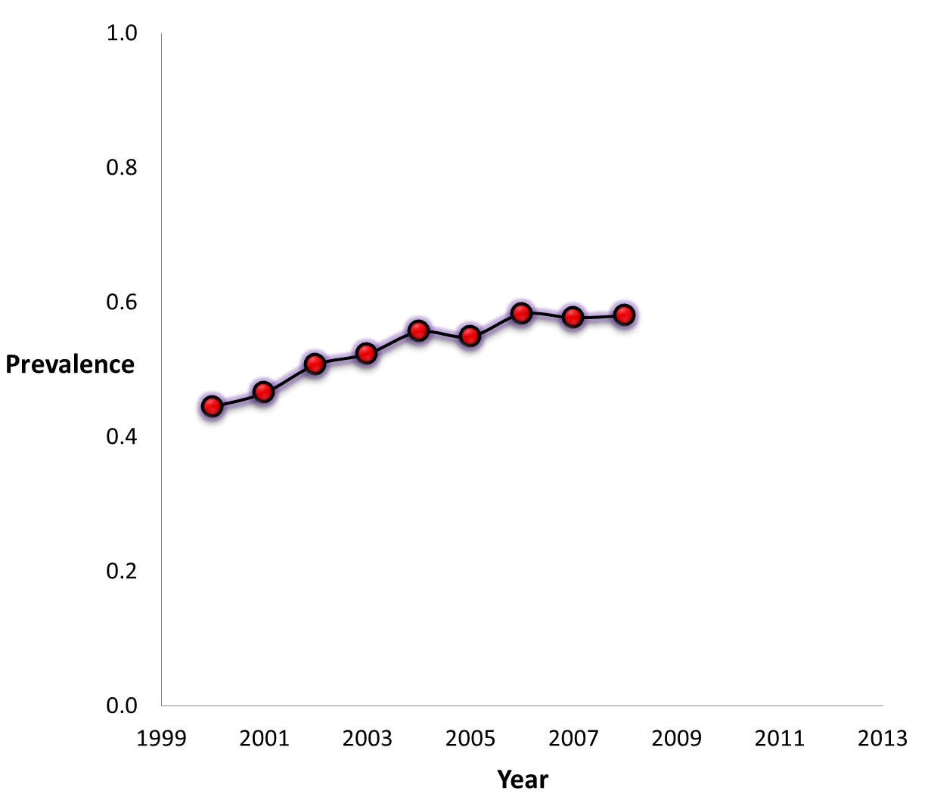

Slide 47
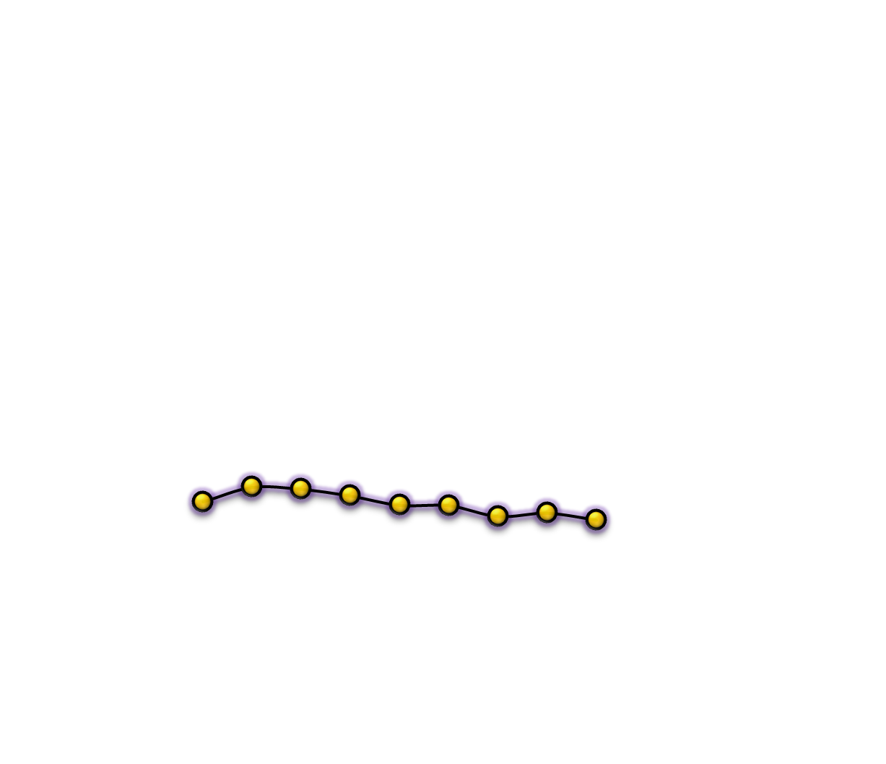
8 | 'Everyday';
7 | 'Several times a week'
6 | 'About once a week'
5 | 'About twice a month'
4 | 'About once a month'
3 | ‘LT once a month'
2 | 'Once or twice'
1 | 'Never'
G
I
.58
N
.44
.29
.24
.18

Slide 48
8 | 'Everyday';
7 | 'Several times a week'
6 | 'About once a week'
Goers
.29
.18
Notes:
Now, let’s look a closer look at Goers.
Remember that we have a five-year slice of the population.
.29 is a average score across the FIVE cohorts
We are missing a lot of information if we don’t account for AGE

Slide 49
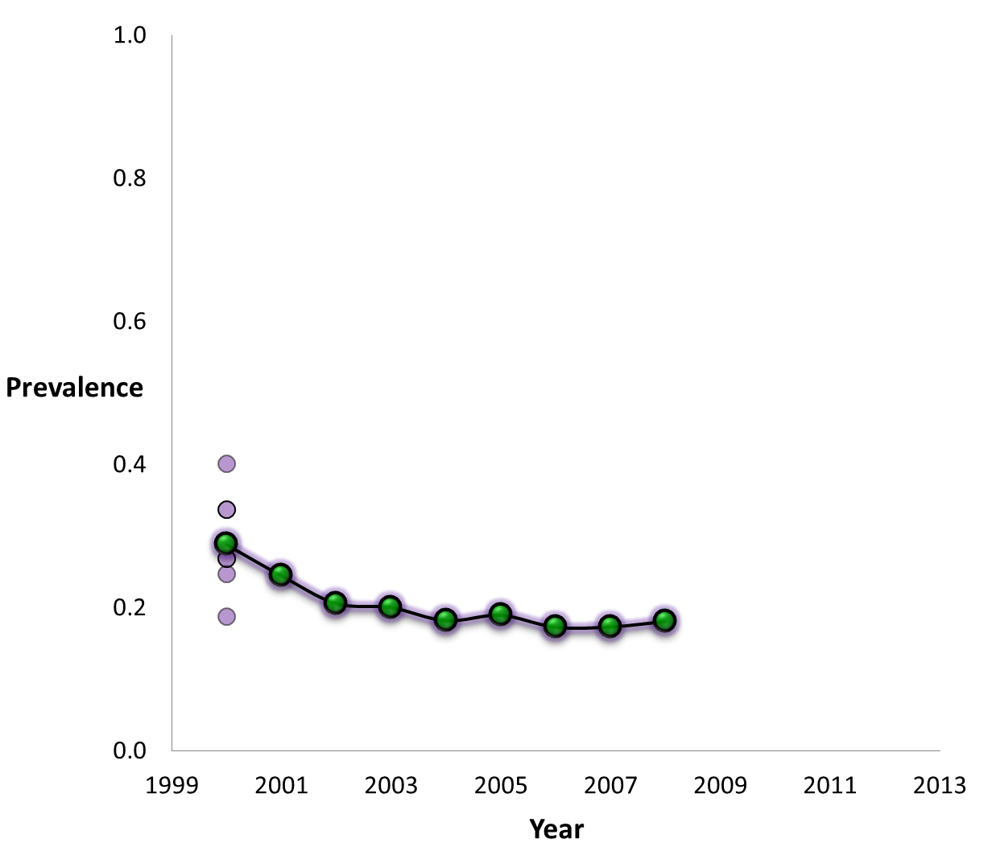
8 | 'Everyday';
7 | 'Several times a week'
6 | 'About once a week'
Goers
16
17
18
19
20
Notes:
The prevalence in each of the cohorts is shown by a purple dot, whereas the green dot represents the prevalence for the entire population without regards to AGE

Slide 50

8 | 'Everyday';
7 | 'Several times a week'
6 | 'About once a week'
Goers
16
24
20
28
Notes:
Nine years later In 2008, the AGE difference remained the same (same people!), but now
So even though the absolute number of years in AGE difference did not change, the location on the AGE continuum did.
As you would expect, a 5 year difference between 16 and 20 yearolds is bigger than a 5 year difference between 24 and 28 yearolds.
Conclusion: As people matured, age predicts/influences religious involvement less.
- age groups become more homogenous
This is especially obvious when we trace the change in prevalence for each cohort

Slide 51
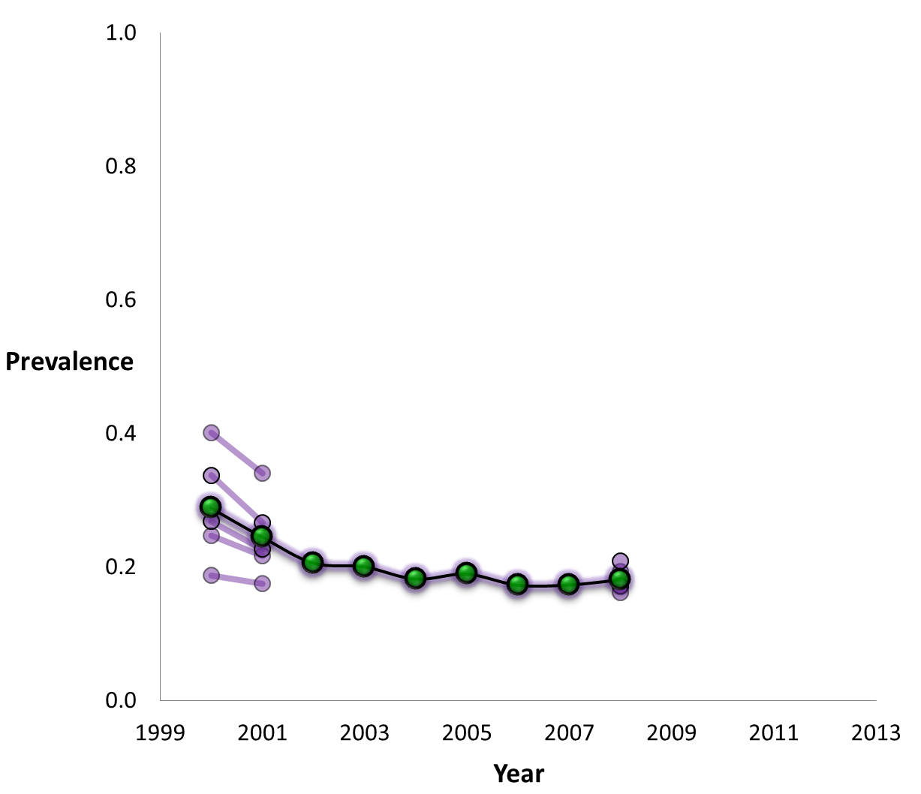
8 | 'Everyday';
7 | 'Several times a week'
6 | 'About once a week'
Goers
16
24
20
28

Slide 52
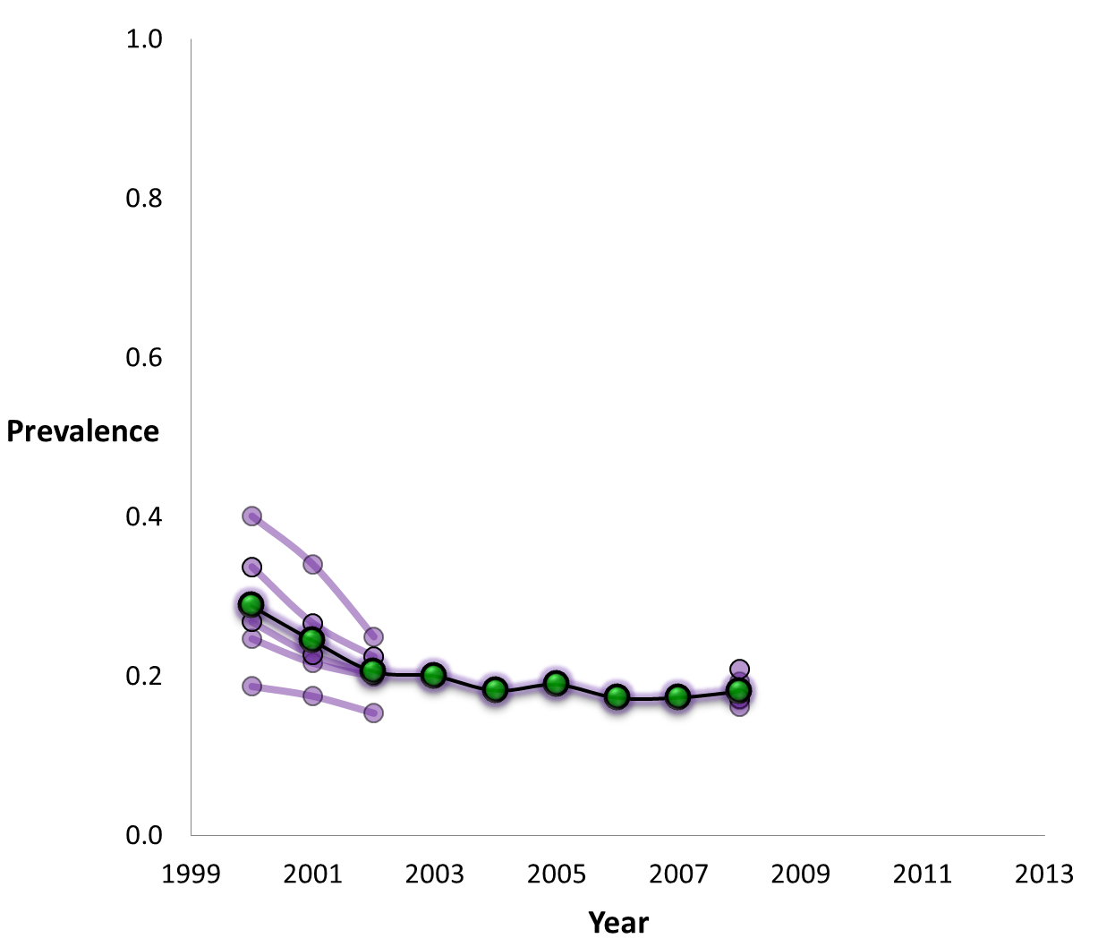
8 | 'Everyday';
7 | 'Several times a week'
6 | 'About once a week'
Goers
16
24
20
28

Slide 53
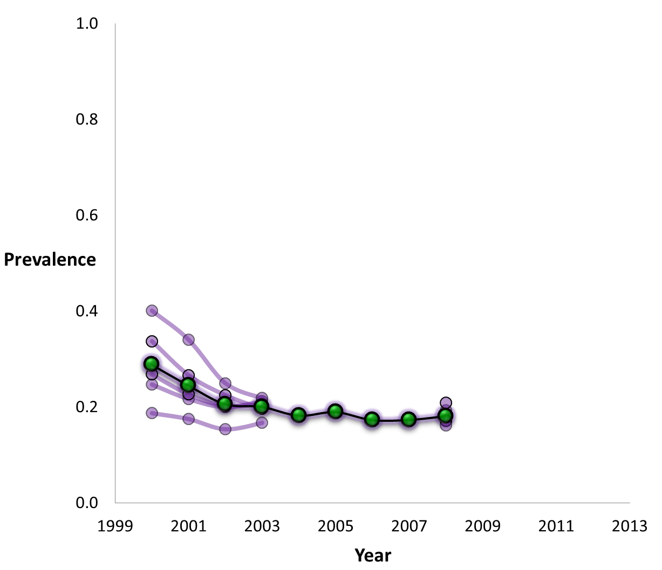
8 | 'Everyday';
7 | 'Several times a week'
6 | 'About once a week'
Goers
16
24
20
28

Slide 54
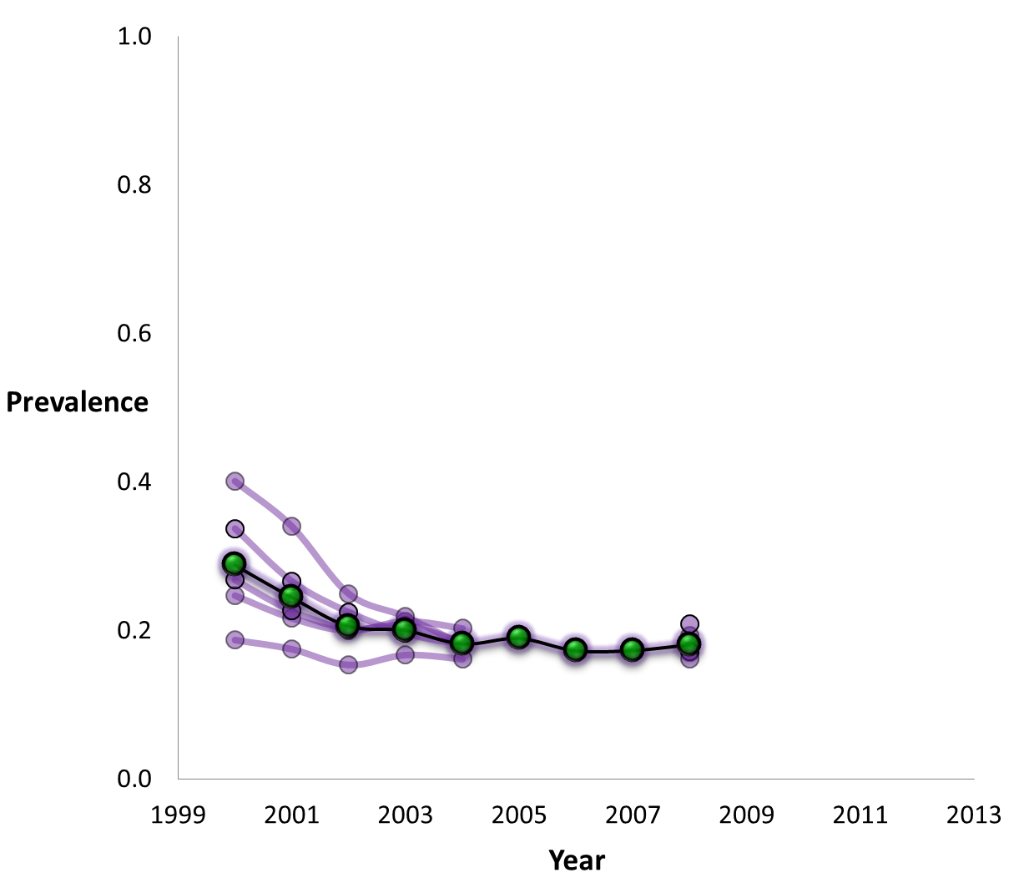
8 | 'Everyday';
7 | 'Several times a week'
6 | 'About once a week'
Goers
16
24
20
28

Slide 55

8 | 'Everyday';
7 | 'Several times a week'
6 | 'About once a week'
Goers
16
24
20
28

Slide 56

8 | 'Everyday';
7 | 'Several times a week'
6 | 'About once a week'
Goers
16
24
20
28

Slide 57
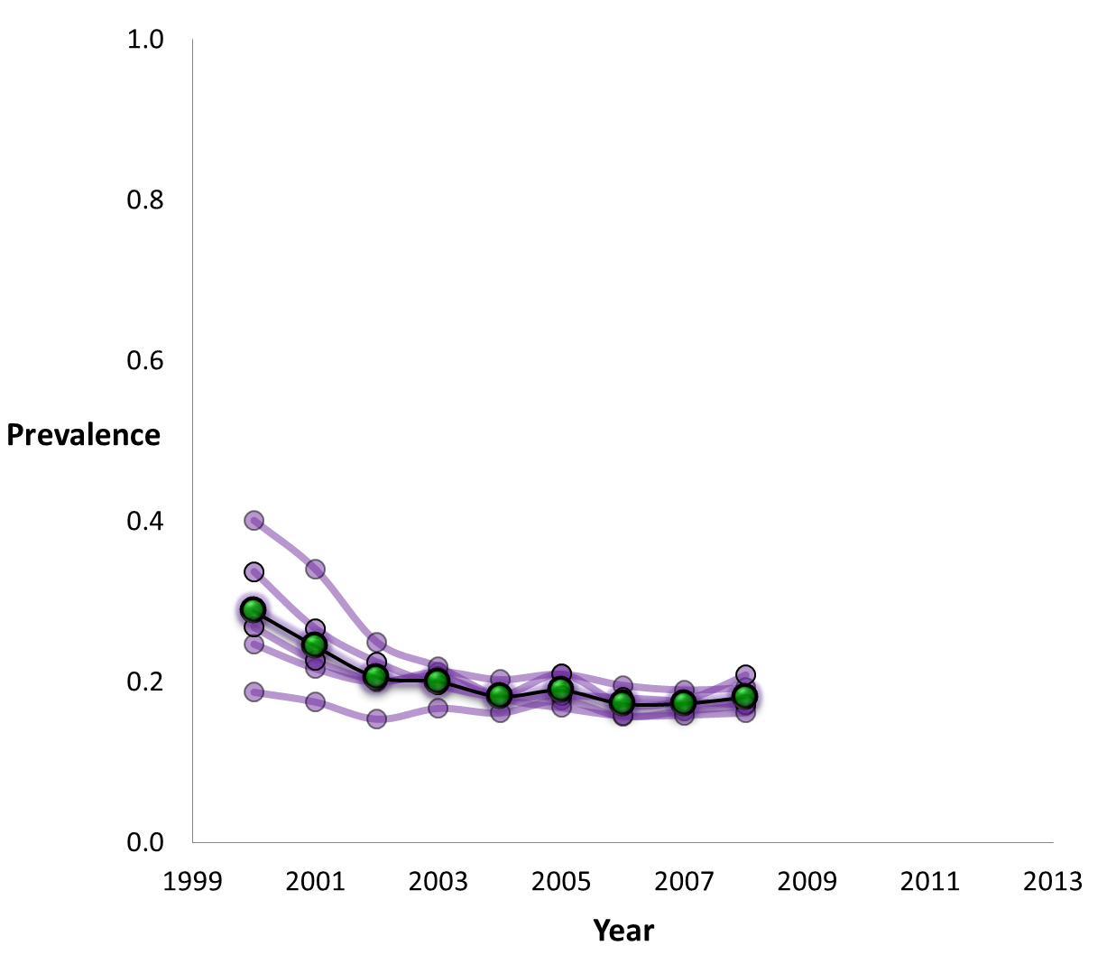
8 | 'Everyday';
7 | 'Several times a week'
6 | 'About once a week'
Goers
16
20
24
20
28
24
Notes:
Age influences Goers only until 20
After you turn 20, your age does not influence your religious participation.
What does this mean? It means that if I were to pick up at random a person from this population, the younger he is, the more religiously active I expect him to be. But only below 20. After 20 years, AGE is a ineffective predictor or religious involvement.
As the age differnce shifts along the continuum, it becomes less meaningful for religious involvement.

Slide 58
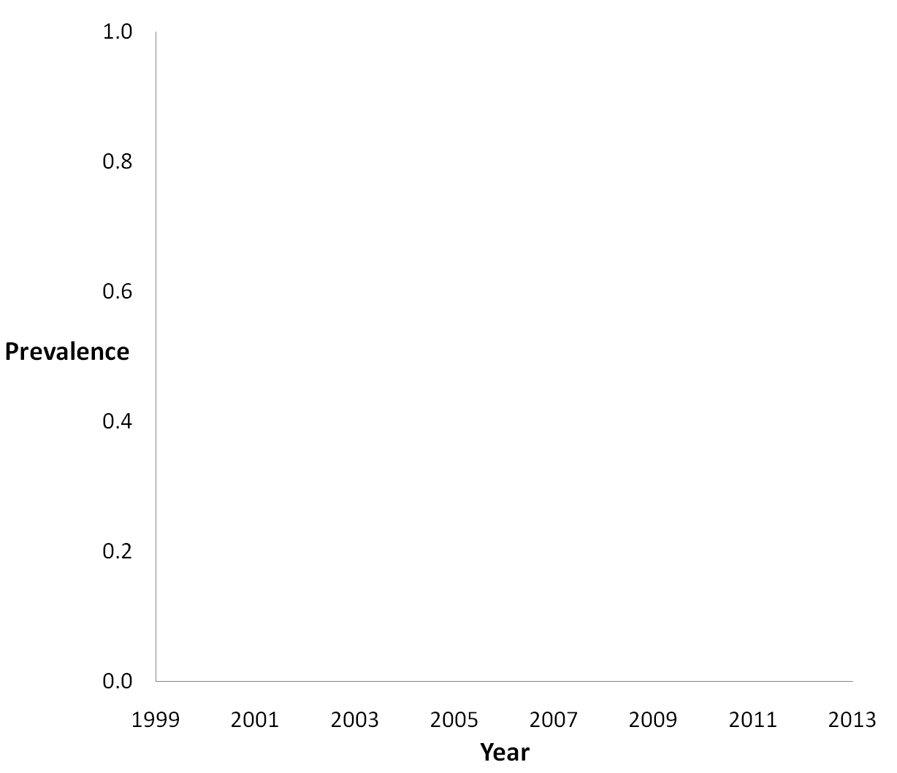
8 | 'Everyday';
7 | 'Several times a week'
6 | 'About once a week'
Goers
Notes:
Age influences Goers only until 20
After you turn 20, your age does not influence your religious participation.
What does this mean? It means that if I were to pick up at random a person from this population, the younger he is, the more religiously active I expect him to be. But only below 20. After 20 years, AGE is a ineffective predictor or religious involvement.

Slide 59
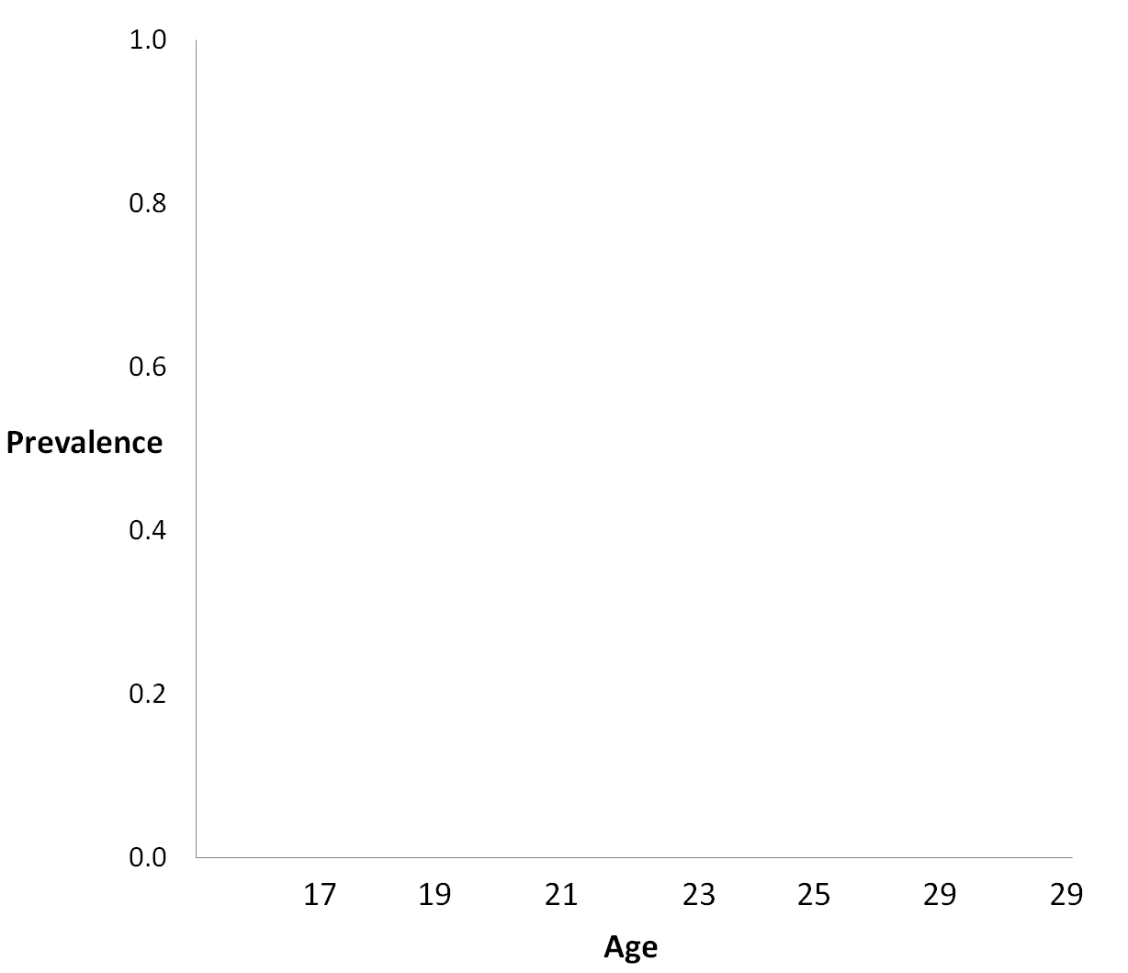
8 | 'Everyday';
7 | 'Several times a week'
6 | 'About once a week'
Goers
Notes:
Age influences Goers only until 20
After you turn 20, your age does not influence your religious participation.
What does this mean? It means that if I were to pick up at random a person from this population, the younger he is, the more religiously active I expect him to be. But only below 20. After 20 years, AGE is a ineffective predictor or religious involvement.

Slide 60
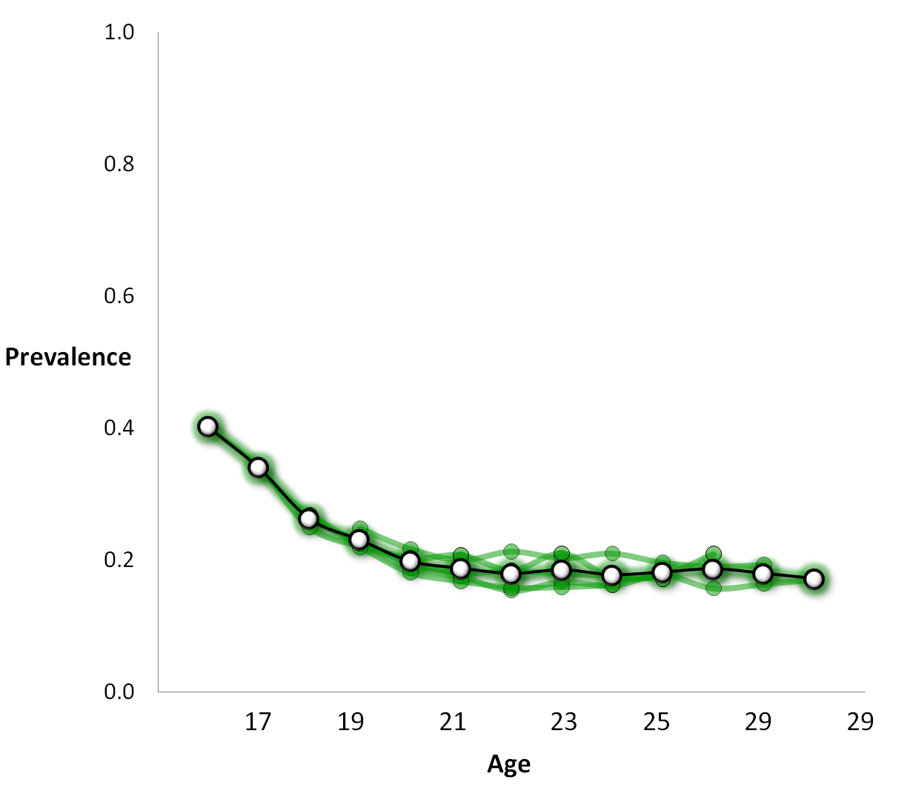
8 | 'Everyday';
7 | 'Several times a week'
6 | 'About once a week'
Goers
.18

Slide 61
8 | 'Everyday';
7 | 'Several times a week'
6 | 'About once a week'
5 | 'About twice a month'
4 | 'About once a month'
3 | ‘LT once a month'
2 | 'Once or twice'
1 | 'Never'
Notes:
So those were GOERS, let’s see how other categories vary on AGE

Slide 62
5 | 'About twice a month'
4 | 'About once a month'
3 | ‘LT once a month'
Irregular
.27
.24

Slide 63
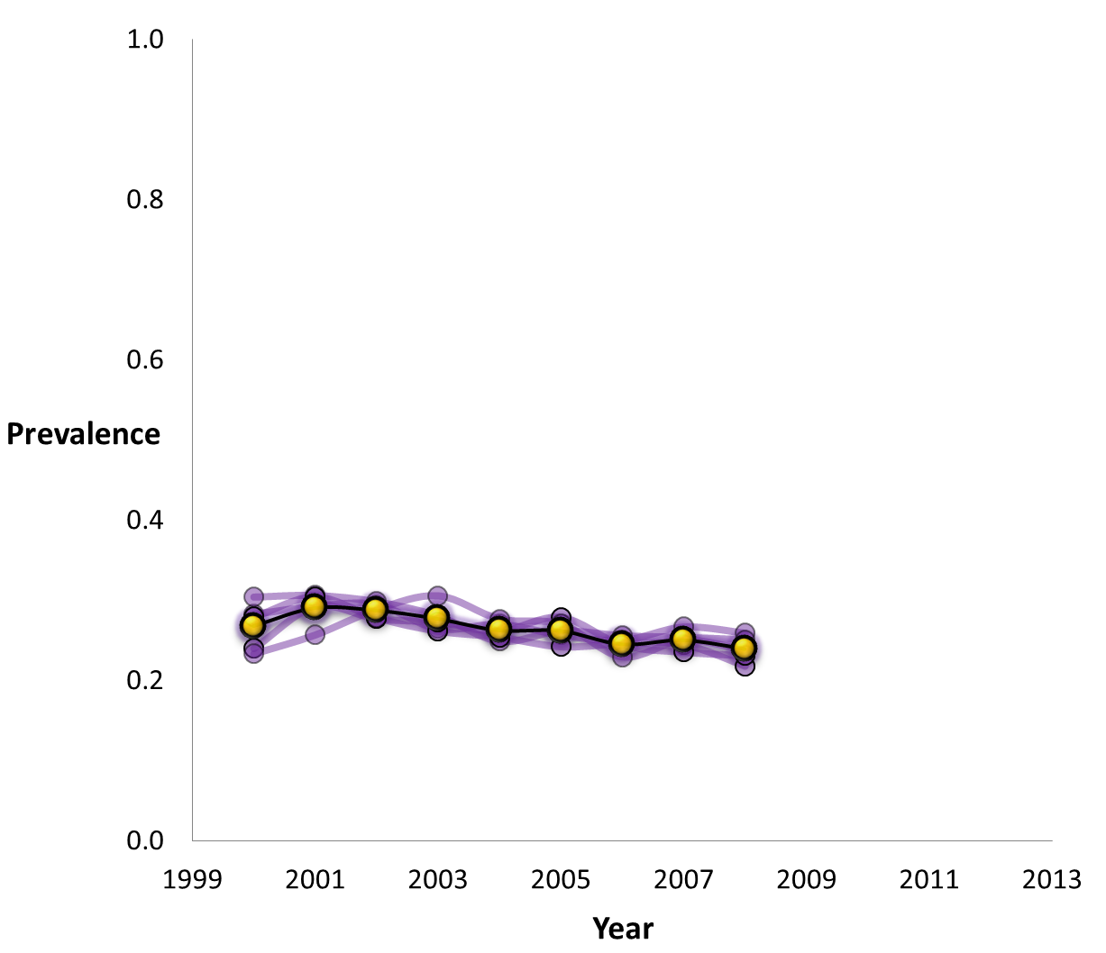
5 | 'About twice a month'
4 | 'About once a month'
3 | ‘LT once a month'
Irregular
Notes:
IRREGULARS, unlike GOERS are not sensitive to AGE
Within the five-year slice of the population, the prevalence of IRREGULARS does not vary much with AGE.
MEANING: If we choose a member of population, the chances that he is a IRREGUAR stay the same regardless of subject’s age.
But you can see a “bump” at

Slide 64
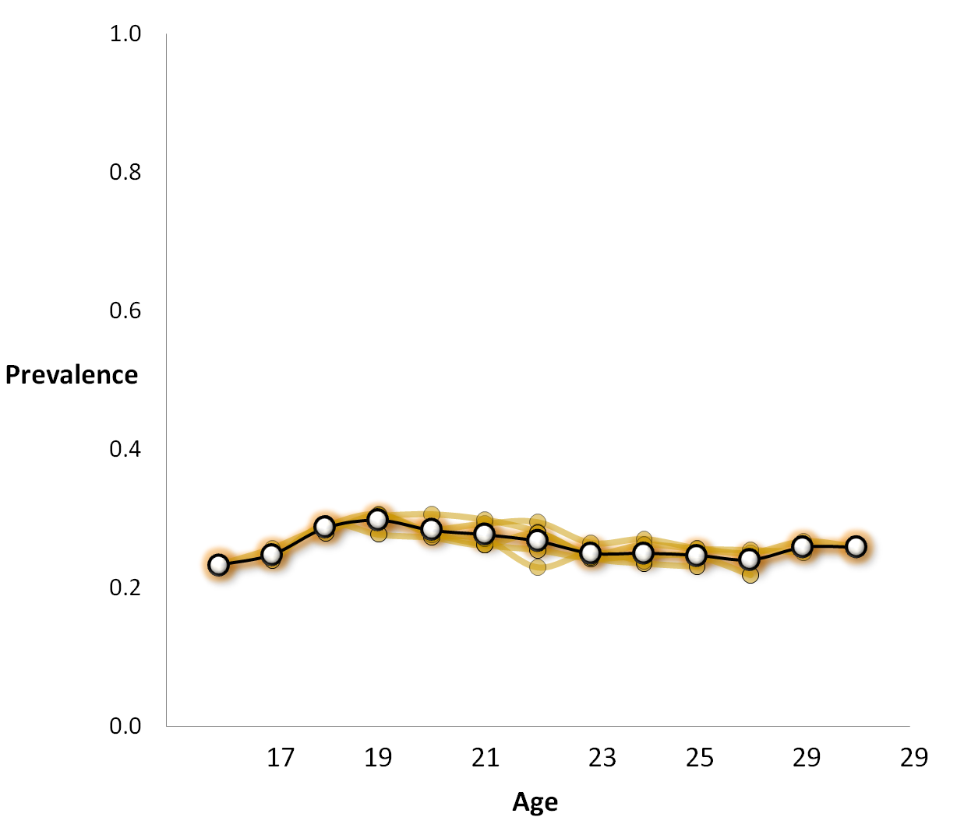
5 | 'About twice a month'
4 | 'About once a month'
3 | ‘LT once a month'
Irregular
.27
Notes:
IRREGULARS, unlike GOERS are not sensitive to AGE
Within the five-year slice of the population, the prevalence of IRREGULARS does not vary much with AGE.
MEANING: If we choose a member of population, the chances that he is a IRREGUAR stay the same regardless of subject’s age.
But you can see a “bump” at

Slide 65
2 | 'Once or twice'
1 | 'Never'
.58
.44
Nongoer

Slide 66
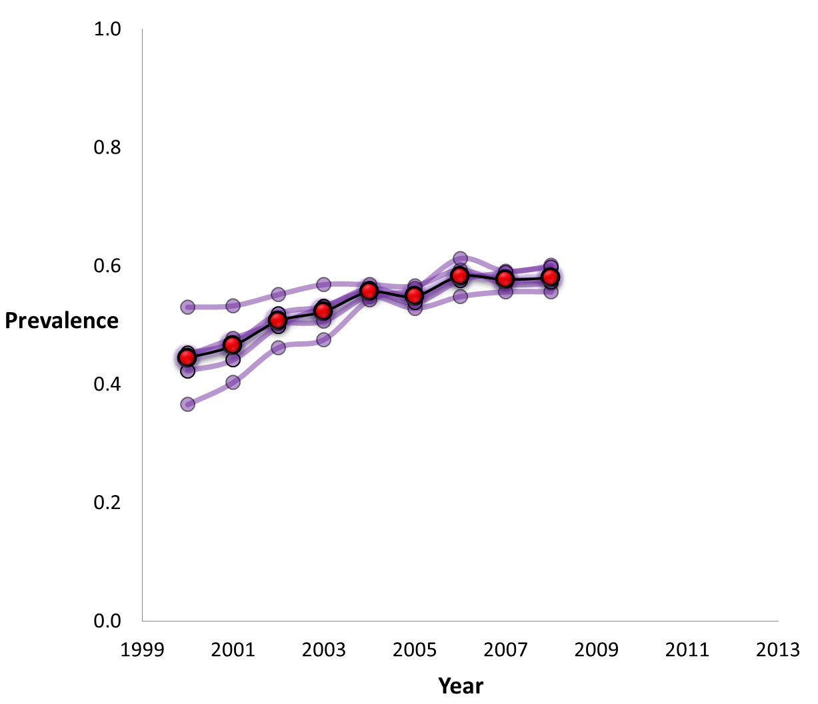
2 | 'Once or twice'
1 | 'Never'
20
24
Nongoer

Slide 67
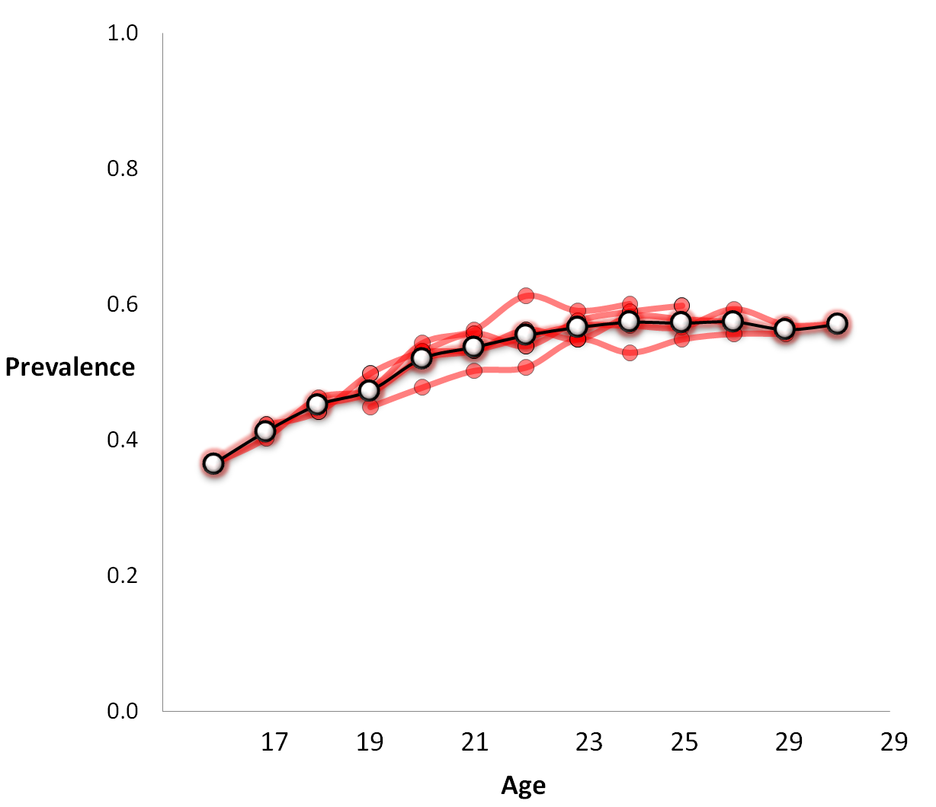
2 | 'Once or twice'
1 | 'Never'
.55
Nongoer

Slide 68
Summary so far
Religious Involvement changes rapidly between 16 and 21 years of age
But does not change much after that
Goers are most AGE diverse / predictive
Irregulars are not AGE diverse at all
Nongoers continue increase in numbers slowly after 21 – secularization effect?

Slide 69
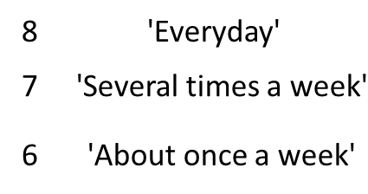
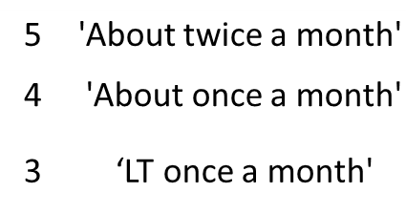
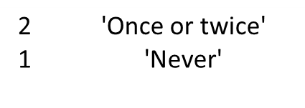
Notes:
Now, let’s begin our return to the EMOSA

Slide 71
Goers
Irregulars
Nongoers

Slide 72
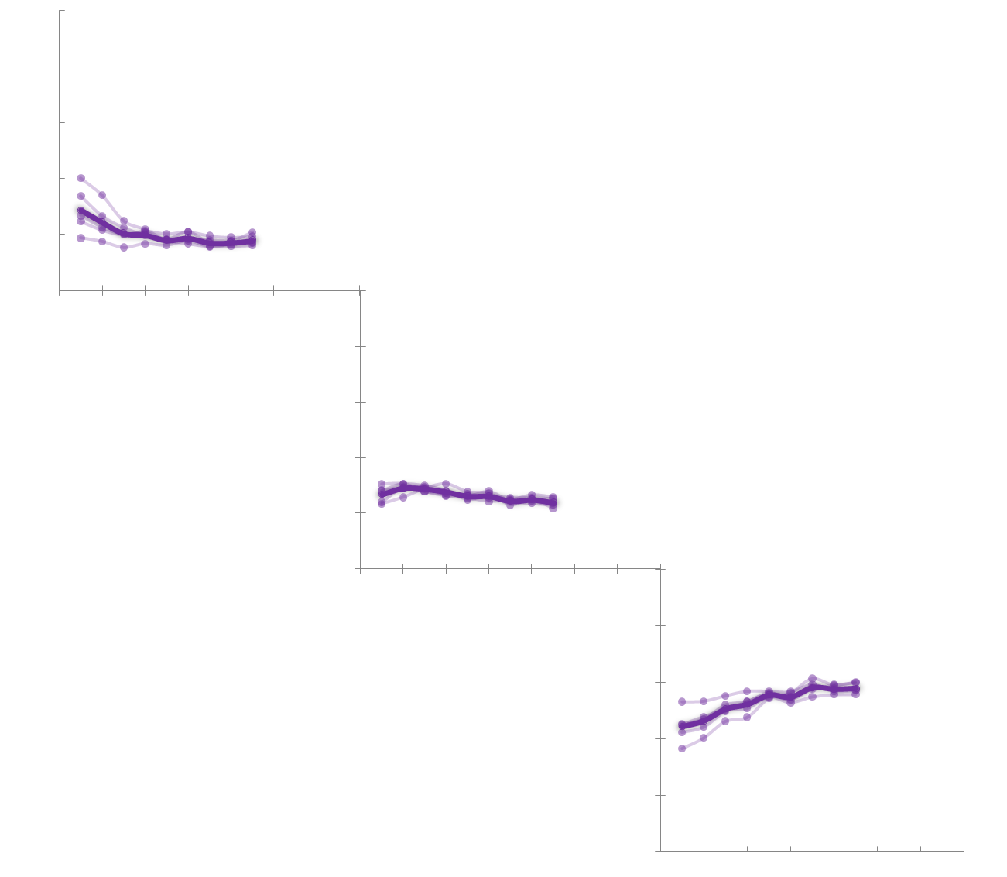
G
I
N

Slide 73
‘01
‘03
‘05
‘07
‘09
‘13
‘01
‘03
‘05
‘07
‘09
‘13
‘01
‘03
‘05
‘07
‘09
1.0
‘13
1.0
0.8
0.8
0.6
0.6
0.4
0.4
0.2
0.2
G
0/1
0/1
‘01
‘03
‘05
‘07
‘09
‘13
‘01
‘03
‘05
‘07
‘09
‘13
‘01
‘03
‘05
‘07
‘09
‘13
0.8
0.8
0.6
0.6
0.4
0.4
0.2
0.2
I
0/1
‘01
‘03
‘05
‘07
‘09
0/1
‘13
‘01
‘03
‘05
‘07
‘09
‘13
‘01
‘03
‘05
‘07
‘09
‘13
0.8
0.8
0.6
0.6
0.4
0.4
0.2
0.2
N
0.0
‘01
‘03
‘05
‘07
‘09
0.0
‘13
‘01
‘03
‘05
‘07
‘09
‘13
‘01
‘03
‘05
‘07
‘09
‘13

Slide 74
‘01
‘03
‘05
‘07
‘09
‘13
‘01
‘03
‘05
‘07
‘09
‘13
‘01
‘03
‘05
‘07
‘09
1.0
‘13
1.0
0.8
0.8
0.6
0.6
.03
0.4
.42
0.4
0.2
0.2
G
0/1
0/1
‘01
‘03
‘05
‘07
‘09
‘13
‘01
‘03
‘05
‘07
‘09
‘13
‘01
‘03
‘05
‘07
‘09
‘13
0.8
0.8
0.6
.29
0.6
0.4
.30
0.4
0.2
0.2
I
0/1
‘01
‘03
‘05
‘07
‘09
0/1
‘13
‘01
‘03
‘05
‘07
‘09
‘13
‘01
‘03
‘05
‘07
‘09
‘13
0.8
0.8
0.6
.12
0.6
.00
0.4
0.4
0.2
0.2
N
0.0
‘01
‘03
‘05
‘07
‘09
0.0
‘13
‘01
‘03
‘05
‘07
‘09
‘13
‘01
‘03
‘05
‘07
‘09
‘13
Notes:
EMOSA converged when diffusion model was applied. The estimated parameters are shown. But what is the meaning of these parameters under Diffusion Model?

Slide 75
‘01
‘03
‘05
‘07
‘09
‘13
‘01
‘03
‘05
‘07
‘09
‘13
‘01
‘03
‘05
‘07
‘09
1.0
‘13
1.0
0.8
0.8
0.6
0.6
0.4
.42
0.4
0.2
0.2
G
0/1
0/1
‘01
‘03
‘05
‘07
‘09
‘13
‘01
‘03
‘05
‘07
‘09
‘13
‘01
‘03
‘05
‘07
‘09
‘13
0.8
0.8
0.6
0.6
0.4
0.4
0.2
0.2
I
0/1
‘01
‘03
‘05
‘07
‘09
0/1
‘13
‘01
‘03
‘05
‘07
‘09
‘13
‘01
‘03
‘05
‘07
‘09
‘13
0.8
0.8
0.6
0.6
0.4
0.4
0.2
0.2
N
0.0
‘01
‘03
‘05
‘07
‘09
0.0
‘13
‘01
‘03
‘05
‘07
‘09
‘13
‘01
‘03
‘05
‘07
‘09
‘13
Notes:
Every year 42% of Goers will become Irregulars
The probability that a randomly selected Goer will become Irregular next year.

Slide 76
‘01
‘03
‘05
‘07
‘09
‘13
‘01
‘03
‘05
‘07
‘09
‘13
‘01
‘03
‘05
‘07
‘09
1.0
‘13
1.0
0.8
0.8
0.6
0.6
0.4
0.4
0.2
0.2
G
0/1
0/1
‘01
‘03
‘05
‘07
‘09
‘13
‘01
‘03
‘05
‘07
‘09
‘13
‘01
‘03
‘05
‘07
‘09
‘13
0.8
0.8
0.6
0.6
0.4
.30
0.4
0.2
0.2
I
0/1
‘01
‘03
‘05
‘07
‘09
0/1
‘13
‘01
‘03
‘05
‘07
‘09
‘13
‘01
‘03
‘05
‘07
‘09
‘13
0.8
0.8
0.6
0.6
0.4
0.4
0.2
0.2
N
0.0
‘01
‘03
‘05
‘07
‘09
0.0
‘13
‘01
‘03
‘05
‘07
‘09
‘13
‘01
‘03
‘05
‘07
‘09
‘13
Notes:
Percentage of Irregulars that make the transition into Nongoers every year.

Slide 77
‘01
‘03
‘05
‘07
‘09
‘13
‘01
‘03
‘05
‘07
‘09
‘13
‘01
‘03
‘05
‘07
‘09
1.0
‘13
1.0
0.8
0.8
0.6
0.6
.03
0.4
0.4
0.2
0.2
G
0/1
0/1
‘01
‘03
‘05
‘07
‘09
‘13
‘01
‘03
‘05
‘07
‘09
‘13
‘01
‘03
‘05
‘07
‘09
‘13
0.8
0.8
0.6
0.6
0.4
0.4
0.2
0.2
I
0/1
‘01
‘03
‘05
‘07
‘09
0/1
‘13
‘01
‘03
‘05
‘07
‘09
‘13
‘01
‘03
‘05
‘07
‘09
‘13
0.8
0.8
0.6
0.6
0.4
0.4
0.2
0.2
N
0.0
‘01
‘03
‘05
‘07
‘09
0.0
‘13
‘01
‘03
‘05
‘07
‘09
‘13
‘01
‘03
‘05
‘07
‘09
‘13
Notes:
Probability that a Goer will become a Nongoer next year
Outro: So far, EMOSA worked only on Aggregate level, never had access to the data of actual transitions among categories, although it estimates the behavior of these transitions by Model parameters.
EMOSA so far – aggregate level only
Do predictions hold in empirical data?
NLSY data provides transitions
Now we have the chance to compare how well EMOSA estimates the characteristics of these transitions to the empirical data.

Slide 78
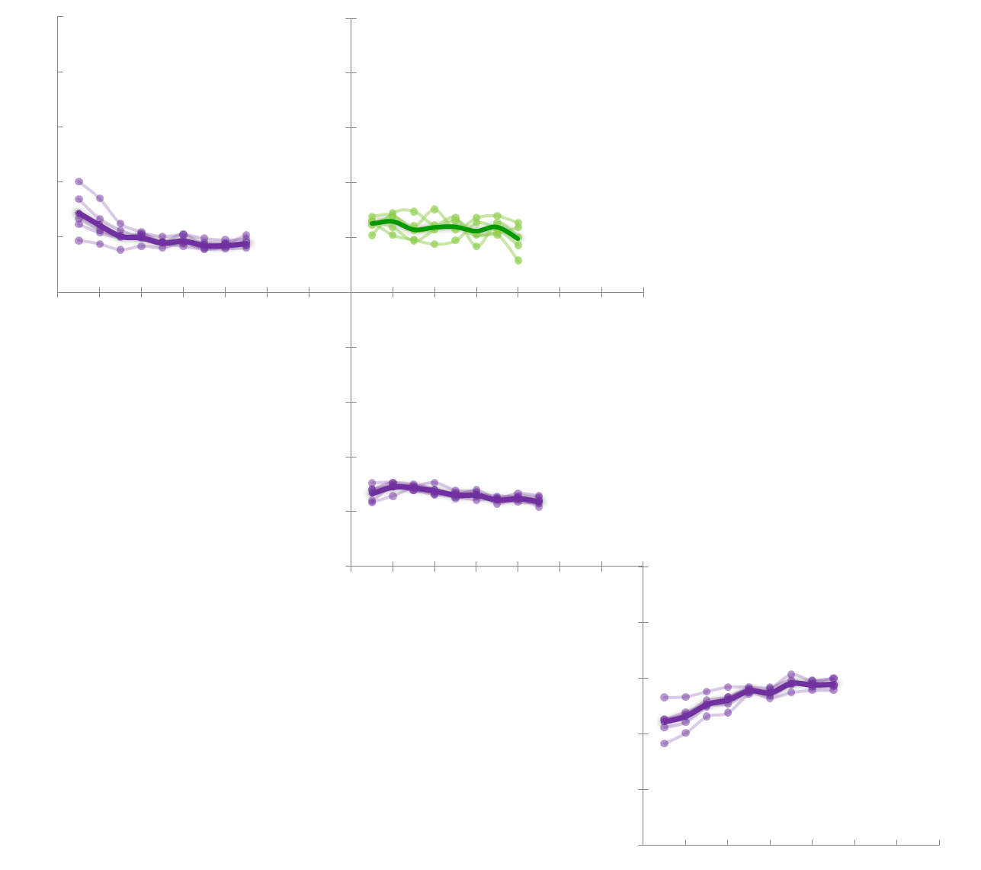
‘01
‘03
‘05
‘07
‘09
‘13
‘01
‘03
‘05
‘07
‘09
‘13
‘01
‘03
‘05
‘07
‘09
1.0
‘13
1.0
0.8
0.8
0.6
0.6
0.4
.42
0.4
0.2
0.2
G
0/1
0/1
‘01
‘03
‘05
‘07
‘09
‘13
‘01
‘03
‘05
‘07
‘09
‘13
‘01
‘03
‘05
‘07
‘09
‘13
0.8
0.8
0.6
0.6
0.4
0.4
0.2
0.2
I
0/1
‘01
‘03
‘05
‘07
‘09
0/1
‘13
‘01
‘03
‘05
‘07
‘09
‘13
‘01
‘03
‘05
‘07
‘09
‘13
0.8
0.8
0.6
0.6
0.4
0.4
0.2
0.2
N
0.0
‘01
‘03
‘05
‘07
‘09
0.0
‘13
‘01
‘03
‘05
‘07
‘09
‘13
‘01
‘03
‘05
‘07
‘09
‘13

Slide 79
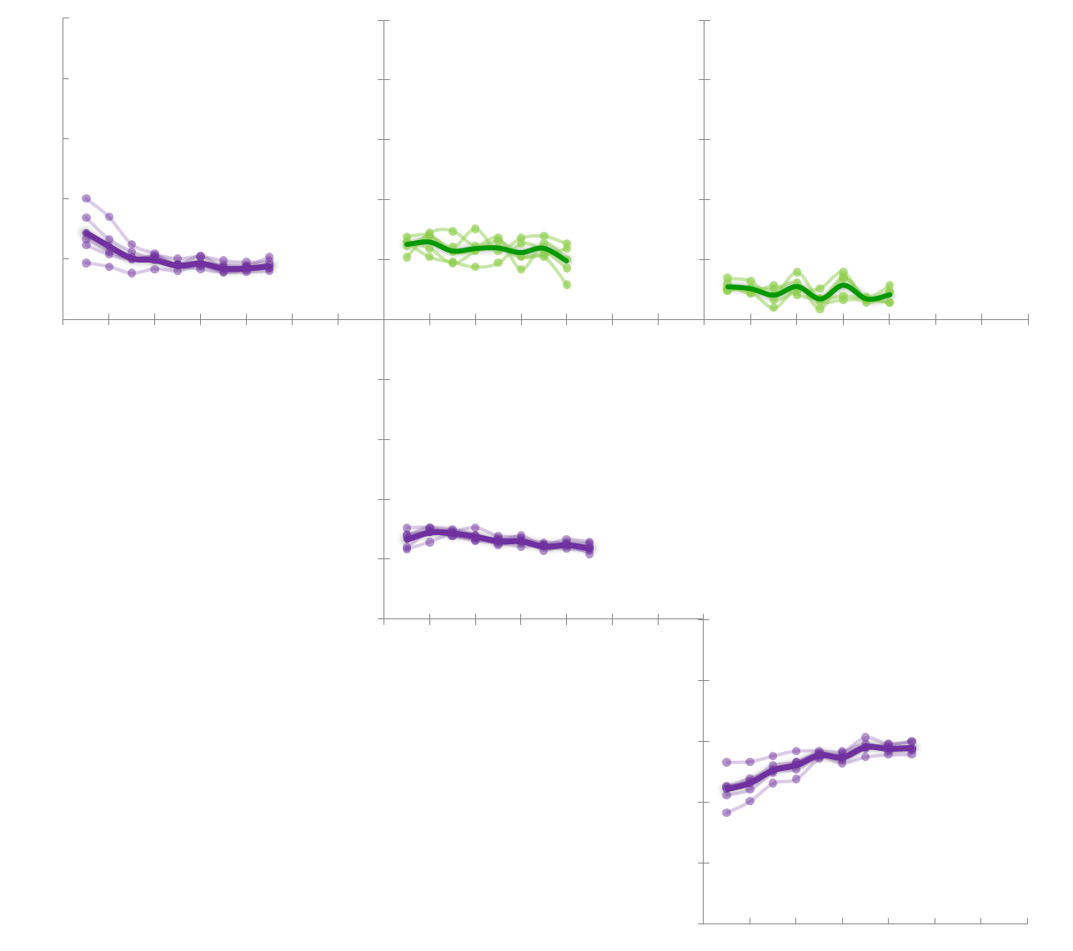
‘01
‘03
‘05
‘07
‘09
‘13
‘01
‘03
‘05
‘07
‘09
‘13
‘01
‘03
‘05
‘07
‘09
1.0
‘13
1.0
0.8
0.8
0.6
0.6
.03
0.4
.42
0.4
0.2
0.2
G
0/1
0/1
‘01
‘03
‘05
‘07
‘09
‘13
‘01
‘03
‘05
‘07
‘09
‘13
‘01
‘03
‘05
‘07
‘09
‘13
0.8
0.8
0.6
0.6
0.4
0.4
0.2
0.2
I
0/1
‘01
‘03
‘05
‘07
‘09
0/1
‘13
‘01
‘03
‘05
‘07
‘09
‘13
‘01
‘03
‘05
‘07
‘09
‘13
0.8
0.8
0.6
.12
0.6
0.4
0.4
0.2
0.2
N
0.0
‘01
‘03
‘05
‘07
‘09
0.0
‘13
‘01
‘03
‘05
‘07
‘09
‘13
‘01
‘03
‘05
‘07
‘09
‘13

Slide 80
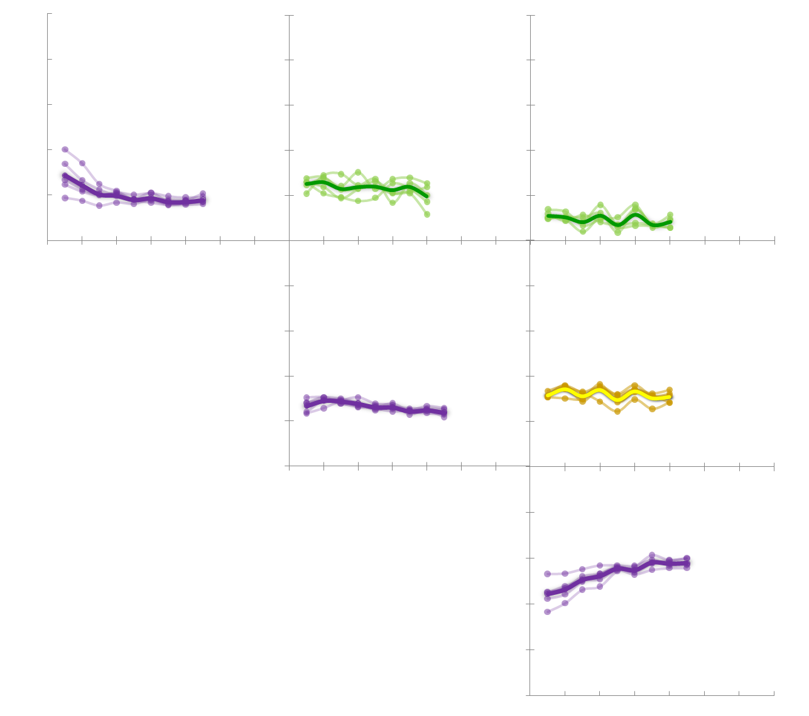
‘01
‘03
‘05
‘07
‘09
‘13
‘01
‘03
‘05
‘07
‘09
‘13
‘01
‘03
‘05
‘07
‘09
1.0
‘13
1.0
0.8
0.8
0.6
0.6
.03
0.4
.42
0.4
0.2
0.2
G
0/1
0/1
‘01
‘03
‘05
‘07
‘09
‘13
‘01
‘03
‘05
‘07
‘09
‘13
‘01
‘03
‘05
‘07
‘09
‘13
0.8
0.8
0.6
0.6
0.4
.30
0.4
0.2
0.2
I
0/1
‘01
‘03
‘05
‘07
‘09
0/1
‘13
‘01
‘03
‘05
‘07
‘09
‘13
‘01
‘03
‘05
‘07
‘09
‘13
0.8
0.8
0.6
0.6
0.4
0.4
0.2
0.2
N
0.0
‘01
‘03
‘05
‘07
‘09
0.0
‘13
‘01
‘03
‘05
‘07
‘09
‘13
‘01
‘03
‘05
‘07
‘09
‘13

Slide 81
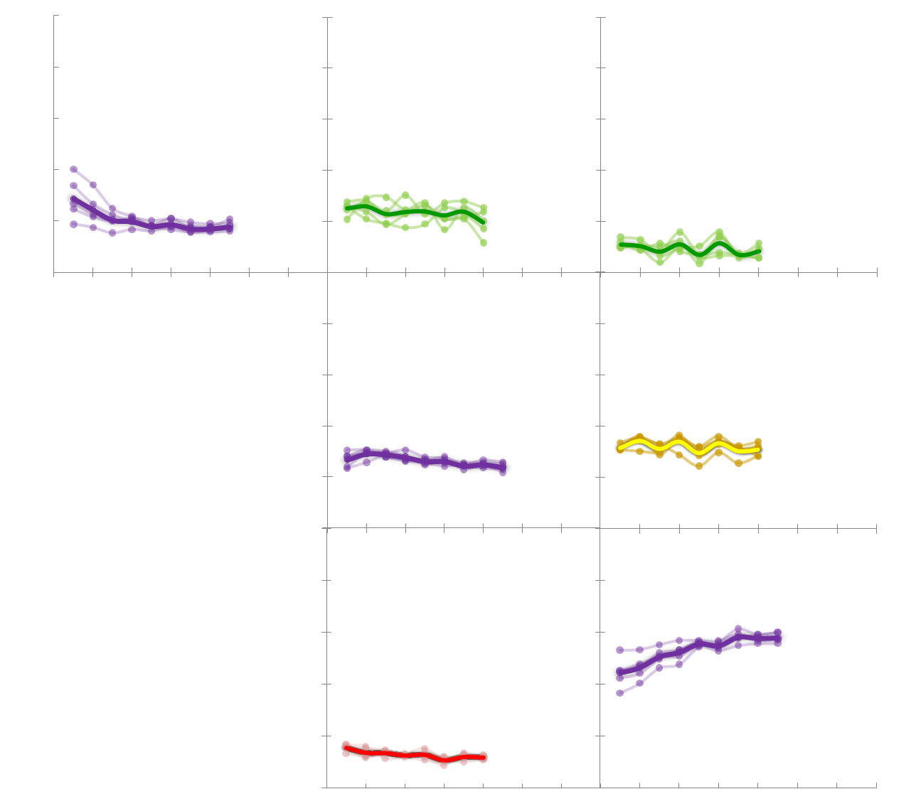
‘01
‘03
‘05
‘07
‘09
‘13
‘01
‘03
‘05
‘07
‘09
‘13
‘01
‘03
‘05
‘07
‘09
1.0
‘13
1.0
0.8
0.8
0.6
0.6
.03
0.4
.42
0.4
0.2
0.2
G
0/1
0/1
‘01
‘03
‘05
‘07
‘09
‘13
‘01
‘03
‘05
‘07
‘09
‘13
‘01
‘03
‘05
‘07
‘09
‘13
0.8
0.8
0.6
0.6
0.4
.30
0.4
0.2
0.2
I
0/1
‘01
‘03
‘05
‘07
‘09
0/1
‘13
‘01
‘03
‘05
‘07
‘09
‘13
‘01
‘03
‘05
‘07
‘09
‘13
0.8
0.8
0.6
.12
0.6
0.4
0.4
0.2
0.2
N
0.0
‘01
‘03
‘05
‘07
‘09
0.0
‘13
‘01
‘03
‘05
‘07
‘09
‘13
‘01
‘03
‘05
‘07
‘09
‘13

Slide 82
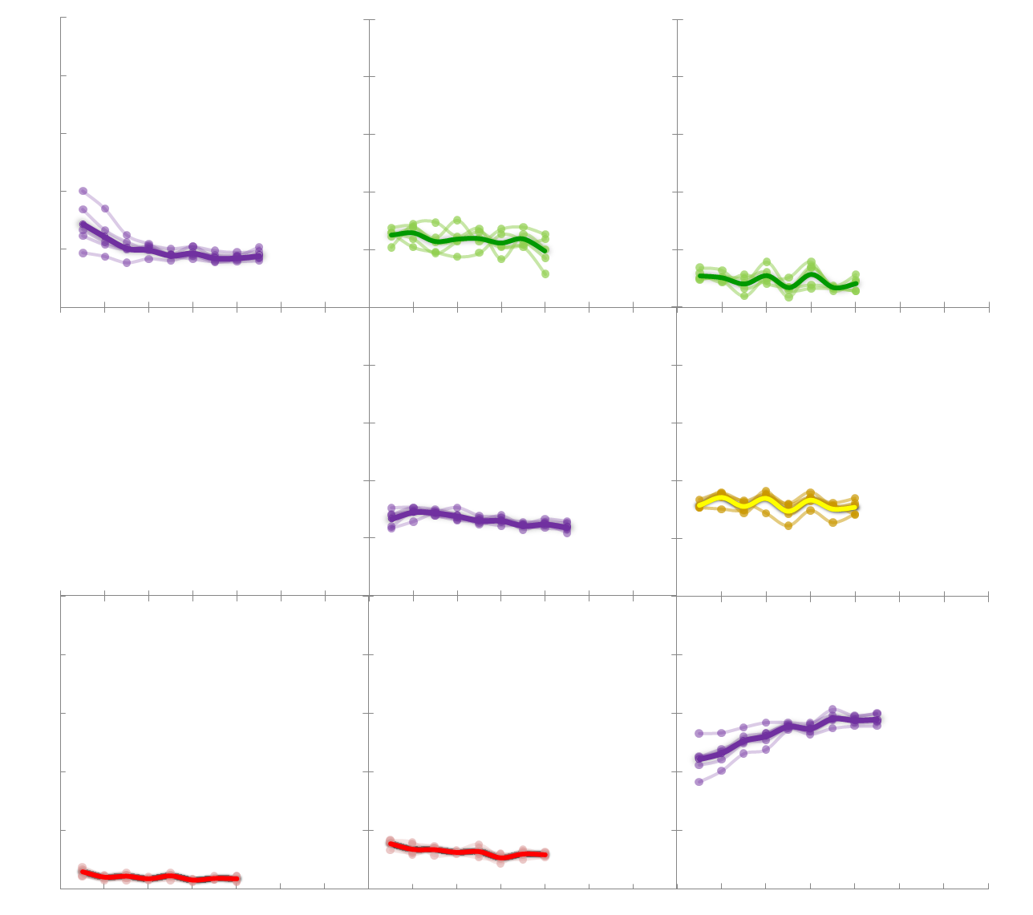
‘01
‘03
‘05
‘07
‘09
‘13
‘01
‘03
‘05
‘07
‘09
‘13
‘01
‘03
‘05
‘07
‘09
1.0
‘13
1.0
0.8
0.8
0.6
0.6
.03
0.4
.42
0.4
0.2
0.2
G
0/1
0/1
‘01
‘03
‘05
‘07
‘09
‘13
‘01
‘03
‘05
‘07
‘09
‘13
‘01
‘03
‘05
‘07
‘09
‘13
0.8
0.8
0.6
0.6
0.4
.30
0.4
0.2
0.2
I
0/1
‘01
‘03
‘05
‘07
‘09
0/1
‘13
‘01
‘03
‘05
‘07
‘09
‘13
‘01
‘03
‘05
‘07
‘09
‘13
0.8
0.8
0.6
.12
0.6
.00
0.4
0.4
0.2
0.2
N
0.0
‘01
‘03
‘05
‘07
‘09
0.0
‘13
‘01
‘03
‘05
‘07
‘09
‘13
‘01
‘03
‘05
‘07
‘09
‘13

Slide 83
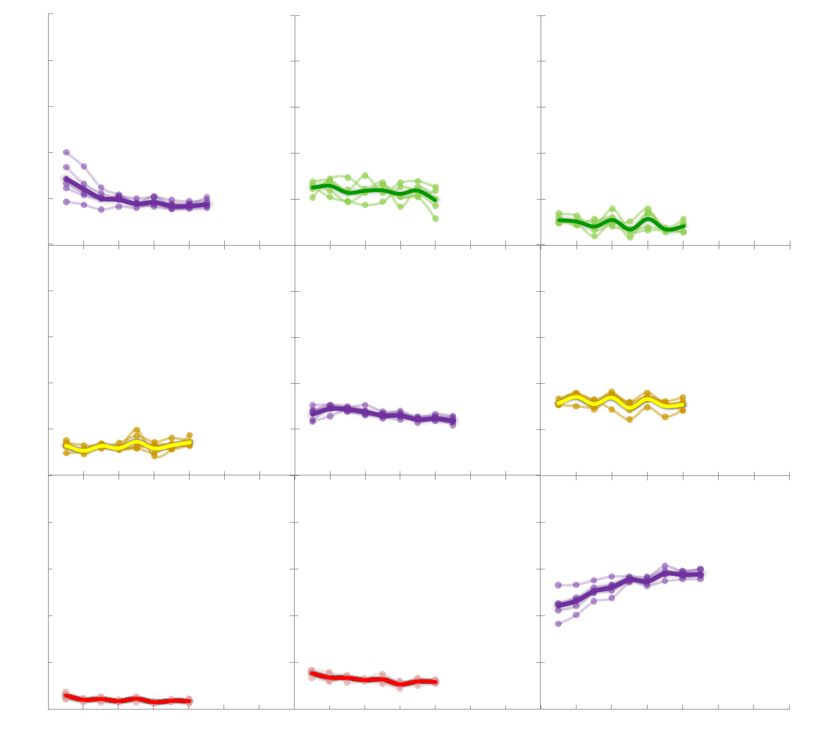
‘01
‘03
‘05
‘07
‘09
‘13
‘01
‘03
‘05
‘07
‘09
‘13
‘01
‘03
‘05
‘07
‘09
1.0
‘13
1.0
0.8
0.8
0.6
0.6
.03
0.4
.42
0.4
0.2
0.2
G
0/1
0/1
‘01
‘03
‘05
‘07
‘09
‘13
‘01
‘03
‘05
‘07
‘09
‘13
‘01
‘03
‘05
‘07
‘09
‘13
0.8
0.8
0.6
.29
0.6
0.4
.30
0.4
0.2
0.2
I
0/1
‘01
‘03
‘05
‘07
‘09
0/1
‘13
‘01
‘03
‘05
‘07
‘09
‘13
‘01
‘03
‘05
‘07
‘09
‘13
0.8
0.8
0.6
.12
0.6
.00
0.4
0.4
0.2
0.2
N
0.0
‘01
‘03
‘05
‘07
‘09
0.0
‘13
‘01
‘03
‘05
‘07
‘09
‘13
‘01
‘03
‘05
‘07
‘09
‘13

Slide 84
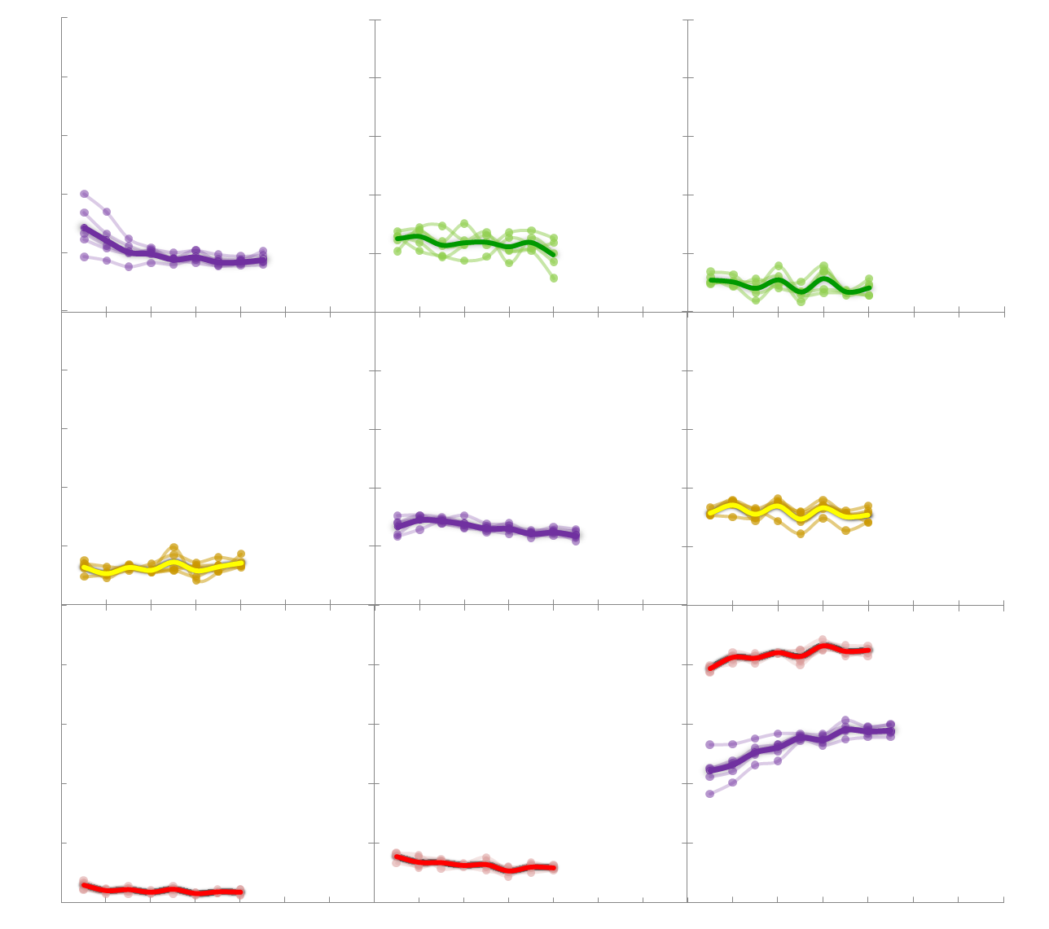
‘01
‘03
‘05
‘07
‘09
‘13
‘01
‘03
‘05
‘07
‘09
‘13
‘01
‘03
‘05
‘07
‘09
1.0
‘13
1.0
0.8
0.8
0.6
0.6
.03
0.4
.42
0.4
0.2
0.2
G
0/1
0/1
‘01
‘03
‘05
‘07
‘09
‘13
‘01
‘03
‘05
‘07
‘09
‘13
‘01
‘03
‘05
‘07
‘09
‘13
0.8
0.8
0.6
.29
0.6
0.4
.30
0.4
0.2
0.2
I
0/1
‘01
‘03
‘05
‘07
‘09
0/1
‘13
‘01
‘03
‘05
‘07
‘09
‘13
‘01
‘03
‘05
‘07
‘09
‘13
0.8
0.8
0.6
.12
0.6
.00
0.4
0.4
0.2
0.2
N
0.0
‘01
‘03
‘05
‘07
‘09
0.0
‘13
‘01
‘03
‘05
‘07
‘09
‘13
‘01
‘03
‘05
‘07
‘09
‘13

Slide 85

‘01
‘03
‘05
‘07
‘09
‘13
‘01
‘03
‘05
‘07
‘09
‘13
‘01
‘03
‘05
‘07
‘09
1.0
‘13
1.0
0.8
0.8
0.6
0.6
.03
0.4
.42
0.4
0.2
0.2
G
0/1
0/1
‘01
‘03
‘05
‘07
‘09
‘13
‘01
‘03
‘05
‘07
‘09
‘13
‘01
‘03
‘05
‘07
‘09
‘13
0.8
0.8
0.6
.29
0.6
0.4
.30
0.4
0.2
0.2
I
0/1
‘01
‘03
‘05
‘07
‘09
0/1
‘13
‘01
‘03
‘05
‘07
‘09
‘13
‘01
‘03
‘05
‘07
‘09
‘13
0.8
0.8
0.6
.12
0.6
.00
0.4
0.4
0.2
0.2
N
0.0
‘01
‘03
‘05
‘07
‘09
0.0
‘13
‘01
‘03
‘05
‘07
‘09
‘13
‘01
‘03
‘05
‘07
‘09
‘13

Slide 86

‘01
‘03
‘05
‘07
‘09
‘13
‘01
‘03
‘05
‘07
‘09
‘13
‘01
‘03
‘05
‘07
‘09
1.0
‘13
1.0
0.8
0.8
0.6
0.6
.03
0.4
.42
0.4
0.2
0.2
G
0/1
0/1
‘01
‘03
‘05
‘07
‘09
‘13
‘01
‘03
‘05
‘07
‘09
‘13
‘01
‘03
‘05
‘07
‘09
‘13
0.8
0.8
0.6
.29
0.6
0.4
.30
0.4
0.2
0.2
I
0/1
‘01
‘03
‘05
‘07
‘09
0/1
‘13
‘01
‘03
‘05
‘07
‘09
‘13
‘01
‘03
‘05
‘07
‘09
‘13
0.8
0.8
0.6
.12
0.6
.00
0.4
0.4
0.2
0.2
N
0.0
‘01
‘03
‘05
‘07
‘09
0.0
‘13
‘01
‘03
‘05
‘07
‘09
‘13
‘01
‘03
‘05
‘07
‘09
‘13

Slide 87

Goers
.03
.42
.29
Irregulars
.30
Nongoers
.12
.00
$χ^{2}$= 7.95, df = 6
Notes:
Fitting General Diffusion Model to the data yielded the following parameter solution

Slide 88
‘01
‘03
‘05
‘07
‘09
‘13
‘01
‘03
‘05
‘07
‘09
‘13
‘01
‘03
‘05
‘07
‘09
1.0
‘13
1.0
0.8
Diffusion
0.8
0.6
0.6
.03
0.4
.42
0.4
0.2
0.2
G
0/1
0/1
‘01
‘03
‘05
‘07
‘09
‘13
‘01
‘03
‘05
‘07
‘09
‘13
‘01
‘03
‘05
‘07
‘09
‘13
0.8
0.8
.29
0.6
0.6
0.4
.30
0.4
0.2
0.2
I
0/1
‘01
‘03
‘05
‘07
‘09
0/1
‘13
‘01
‘03
‘05
‘07
‘09
‘13
‘01
‘03
‘05
‘07
‘09
‘13
0.8
0.8
0.6
.12
0.6
.00
0.4
0.4
0.2
0.2
N
0.0
‘01
‘03
‘05
‘07
‘09
0.0
‘13
‘01
‘03
‘05
‘07
‘09
‘13
‘01
‘03
‘05
‘07
‘09
‘13

Slide 89

‘01
‘03
‘05
‘07
‘09
‘13
‘01
‘03
‘05
‘07
‘09
‘13
‘01
‘03
‘05
‘07
‘09
1.0
‘13
1.0
0.8
Contagion
0.8
0.6
0.6
0.4
0.4
0.2
0.2
G
0/1
0/1
‘01
‘03
‘05
‘07
‘09
‘13
‘01
‘03
‘05
‘07
‘09
‘13
‘01
‘03
‘05
‘07
‘09
‘13
0.8
0.8
0.6
0.6
0.4
0.4
0.2
0.2
I
0/1
‘01
‘03
‘05
‘07
‘09
0/1
‘13
‘01
‘03
‘05
‘07
‘09
‘13
‘01
‘03
‘05
‘07
‘09
‘13
0.8
0.8
0.6
0.6
0.4
0.4
0.2
0.2
N
0.0
‘01
‘03
‘05
‘07
‘09
0.0
‘13
‘01
‘03
‘05
‘07
‘09
‘13
‘01
‘03
‘05
‘07
‘09
‘13

Slide 90
‘01
‘03
‘05
‘07
‘09
‘13
‘01
‘03
‘05
‘07
‘09
‘13
‘01
‘03
‘05
‘07
‘09
1.0
‘13
1.0
0.8
Diffusion
0.8
0.6
0.6
0.4
0.4
0.2
0.2
G
0/1
0/1
‘01
‘03
‘05
‘07
‘09
‘13
‘01
‘03
‘05
‘07
‘09
‘13
‘01
‘03
‘05
‘07
‘09
‘13
0.8
0.8
0.6
0.6
0.4
0.4
0.2
0.2
I
0/1
‘01
‘03
‘05
‘07
‘09
0/1
‘13
‘01
‘03
‘05
‘07
‘09
‘13
‘01
‘03
‘05
‘07
‘09
‘13
0.8
0.8
0.6
0.6
0.4
0.4
0.2
0.2
N
0.0
‘01
‘03
‘05
‘07
‘09
0.0
‘13
‘01
‘03
‘05
‘07
‘09
‘13
‘01
‘03
‘05
‘07
‘09
‘13

Slide 91
Religious Behavior Resume
Nongoers are likely to stay goers. Highest resilience
Goers rarely become Nongoers, they first become irregulars.
Nongoers never move back to goers, they become irregulars, for at least awhile
Goers are the most resilient, but once out, lots happens

Slide 92
Lifecycle/Generation Resume
Five year difference among cohorts is noticeable only until 21 years of age – evidence for lifecycle effect.
Categories stabilize at .18(Goers), .27(Irregulars), and .55(Nongoers) – psychological profile of this generation
System self-regulates: steady ratios and steady transition rates.

Slide 93
EMOSA Resume
Diffusion explains data better
Constant rate of transitions as a function of originating category
Originating vs. Originating + Destination
Decrease in religious involvement has evidence for contagion, while increase is purely diffusive.
EMOSA creates a digital fossil of the behavior

Slide 94
‘01
‘03
‘05
‘07
‘09
‘13
‘01
‘03
‘05
‘07
‘09
‘13
‘01
‘03
‘05
‘07
‘09
1.0
‘13
1.0
0.8
Diffusion
0.8
0.6
0.6
.03
0.4
.42
0.4
0.2
0.2
G
0/1
0/1
‘01
‘03
‘05
‘07
‘09
‘13
‘01
‘03
‘05
‘07
‘09
‘13
‘01
‘03
‘05
‘07
‘09
‘13
0.8
0.8
.29
0.6
0.6
0.4
.30
0.4
0.2
0.2
I
0/1
‘01
‘03
‘05
‘07
‘09
0/1
‘13
‘01
‘03
‘05
‘07
‘09
‘13
‘01
‘03
‘05
‘07
‘09
‘13
0.8
0.8
0.6
.12
0.6
.00
0.4
0.4
0.2
0.2
N
0.0
‘01
‘03
‘05
‘07
‘09
0.0
‘13
‘01
‘03
‘05
‘07
‘09
‘13
‘01
‘03
‘05
‘07
‘09
‘13

Slide 95
Questions?

